Slide 1
Lesson 2.1 Angles and Congruence
Workbook pages 61-66
Content Objective
Students identify and use angles, angle parts, and special angle pairs.

Slide 2
Florida’s B.E.S.T. Standards for Mathematics
MA.912.GR.1.6
Solve mathematical and real-world problems involving congruence or similarity in two-dimensional figures.
MA.912.GR.5.1
Construct a copy of a segment or an angle.
MA.912.GR.5.2
Construct the bisector of a segment or an angle, including the perpendicular bisector of a line segment.

Slide 3

Learn
Angles
Lines and portions of lines intersect to form angles.
A ray is the part of a line consisting of a point on the line, called the endpoint of the ray, together with all of the collinear points on one side of the endpoint. | Rays are named by stating the endpoint first and then another point on the ray.

Slide 4
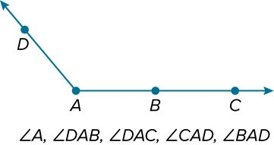
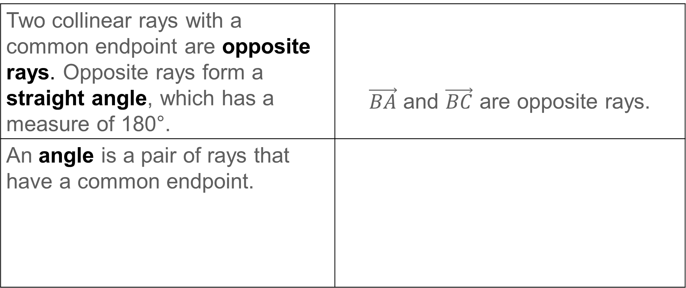
Learn
Angles
Two collinear rays with a common endpoint are opposite rays. Opposite rays form a straight angle, which has a measure of 180°. | $\vec{BA}$ and $\vec{BC}$ are opposite rays.
An angle is a pair of rays that have a common endpoint.

Slide 5
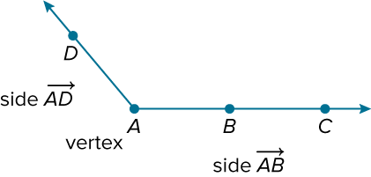
Learn
Angles
The rays are called sides of the angle. The common endpoint is the vertex.

Slide 6
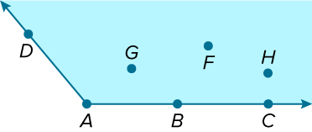
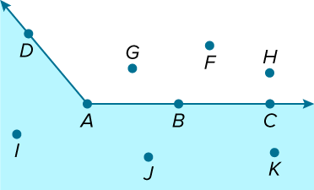
Learn
Angles
An angle divides a plane into three distinct parts.
Points D, A, B, and C lie on the angle. Points G, F, and H lie in the interior of the angle.
Points I, J, and K lie in the exterior of the angle.

Slide 7
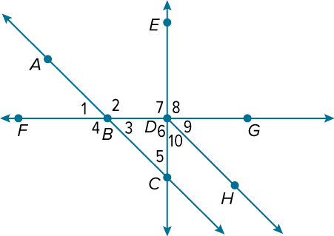
Example 1
Identify Angles
Use the figure to identify the angles or parts of angles that satisfy each given condition.
a. Name all the angles that have D as a vertex.
b. Name the sides of ∠2.
c. Name a point in the interior of ∠FDE.
d. Name all of the points in the exterior of ∠FDE.

Slide 8
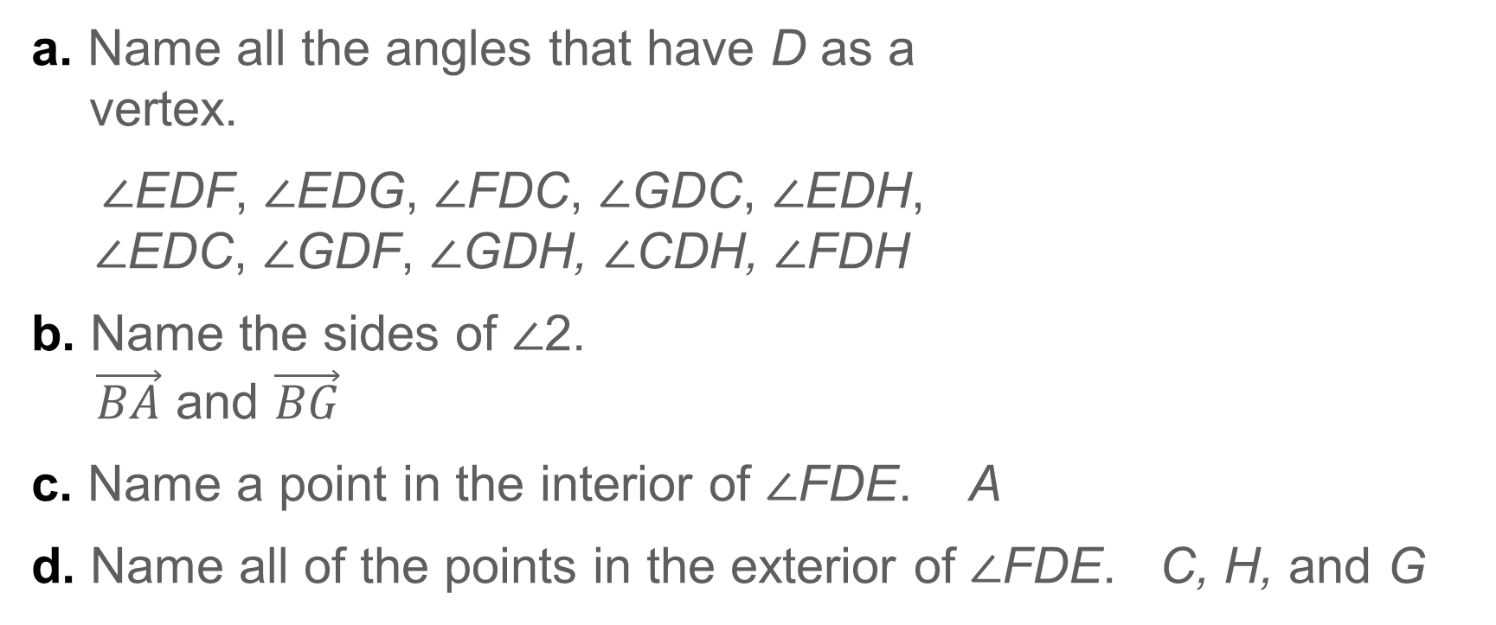
Example 1
Identify Angles
a. Name all the angles that have D as a
vertex.
∠EDF, ∠EDG, ∠FDC, ∠GDC, ∠EDH,
∠EDC, ∠GDF, ∠GDH, ∠CDH, ∠FDH
b. Name the sides of ∠2.
$\vec{BA}$ and $\vec{BG}$
c. Name a point in the interior of ∠FDE. A
d. Name all of the points in the exterior of ∠FDE. C, H, and G

Slide 9
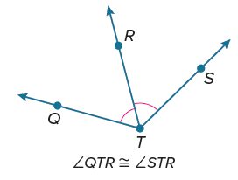
Learn
Congruent Angles
The measure of an angle is the measure in degrees of the space between the sides of the angle. Angles that have the same measure are congruent angles. Congruent angles are indicated on the figure by a matching number of arcs.

Slide 10
Learn
Congruent Angles
A ray or segment that divides an angle into two congruent angles is an angle bisector. You can create the angle bisector of any angle without knowing the measure of the angle.

Slide 11
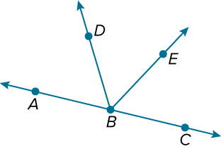
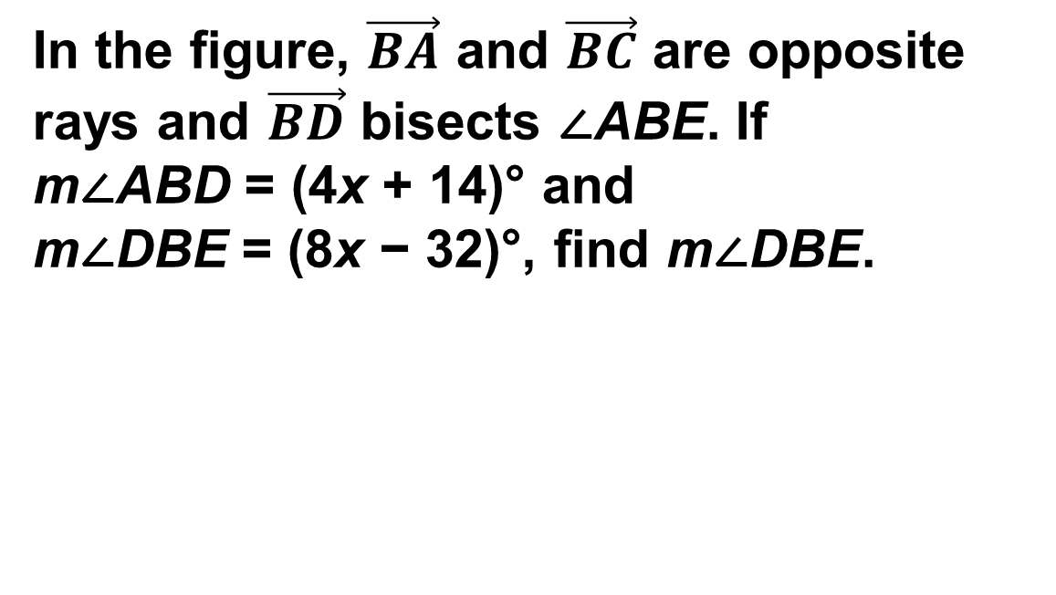
Example 2
Congruent Angles and Angle Bisectors
In the figure, $\vec{BA}$ and $\vec{BC}$ are opposite rays and $\vec{BD}$ bisects ∠ABE. If m∠ABD = (4x + 14)° and m∠DBE = (8x − 32)°, find m∠DBE.

Slide 12
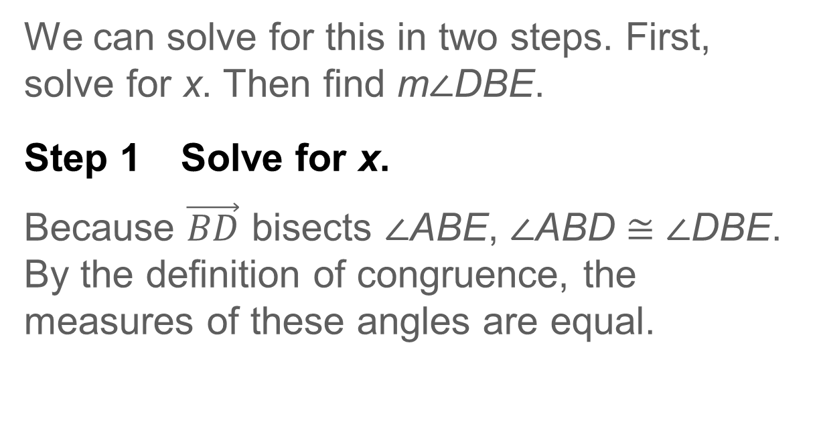
Example 2
Congruent Angles and Angle Bisectors
We can solve for this in two steps. First, solve for x. Then find m∠DBE.
Step 1 Solve for x.
Because $\vec{BD}$ bisects ∠ABE, ∠ABD ≅ ∠DBE. By the definition of congruence, the measures of these angles are equal.

Slide 13
Example 2
Congruent Angles and Angle Bisectors
m∠ABD = m∠DBE | Definition of congruent angles
(4x + 14)° = (8x − 32)° | Substitution
14° = 4x° − 32° | Subtract 4x° from each side.
46° = 4x° | Add 32° to each side.
11.5 = x | Divide each side by 4°.

Slide 14
Example 2
Congruent Angles and Angle Bisectors
Step 2 Find the angle measure.
Because we are asked to find m∠DBE, we substitute 11.5 for x in the expression.
m∠DBE = (8x − 32)° | Given
= [8(11.5) − 32]° | Substitute.
= 92°− 32° or 60° | Simplify.
m∠DBE = 60°

Slide 15
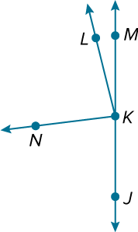
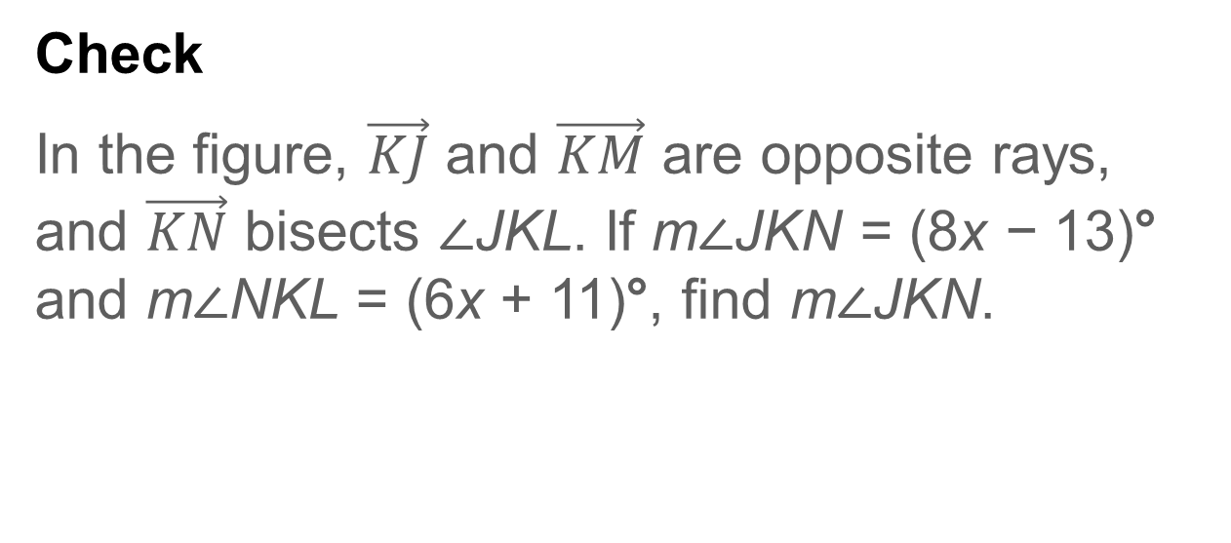
Example 2
Congruent Angles and Angle Bisectors
Check
In the figure, $\vec{KJ}$ and $\vec{KM}$ are opposite rays, and $\vec{KN}$ bisects ∠JKL. If m∠JKN = (8x − 13)° and m∠NKL = (6x + 11)°, find m∠JKN.

Slide 16
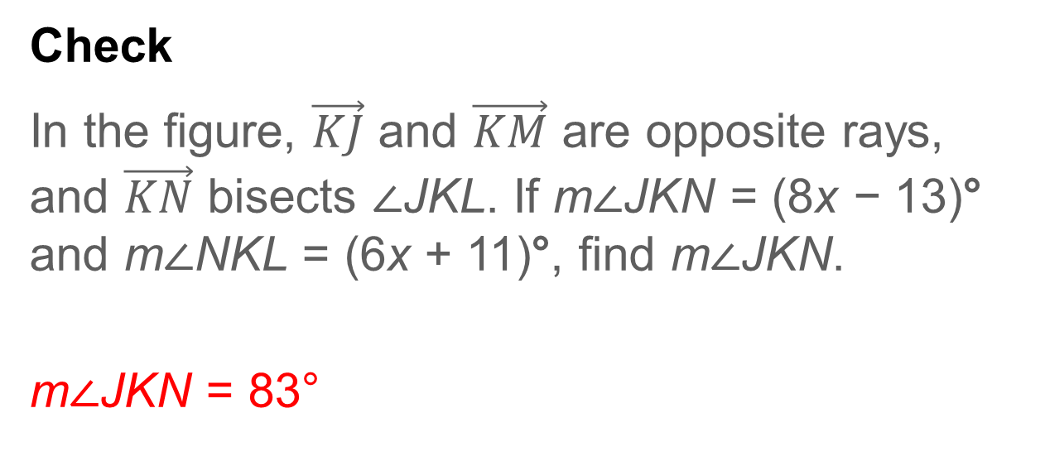
Example 2
Congruent Angles and Angle Bisectors
Check
In the figure, $\vec{KJ}$ and $\vec{KM}$ are opposite rays, and $\vec{KN}$ bisects ∠JKL. If m∠JKN = (8x − 13)° and m∠NKL = (6x + 11)°, find m∠JKN.
m∠JKN = 83°
Notes:
m∠JKN = 83°

Slide 17
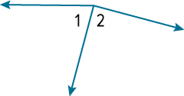
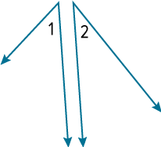
Learn
Special Angle Pairs
Special Angle Pairs
Special Angle Pair Definition | Examples | Nonexamples
Adjacent angles are two angles that lie in the same plane, have a common vertex and a common side, but have no common interior points. | ∠1 and ∠2 are adjacent angles.

Slide 18

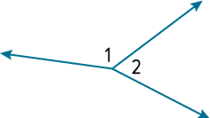
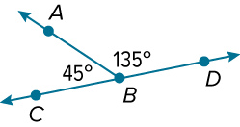
Learn
Special Angle Pairs
Special Angle Pairs
Special Angle Pair Definition | Examples | Nonexamples
A linear pair is a pair of adjacent angles with noncommon sides that are opposite rays. | ∠1 and ∠2 are a linear pair.
The sum of the angle measures is 180°.

Slide 19
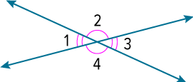
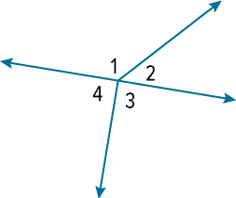
Learn
Special Angle Pairs
Special Angle Pairs
Special Angle Pair Definition | Examples | Nonexamples
Vertical angles are the two nonadjacent angles formed by two intersecting lines. Vertical angles are congruent. | ∠1 and ∠3 are vertical angles. ∠2 and ∠4 are vertical angles.

Slide 20
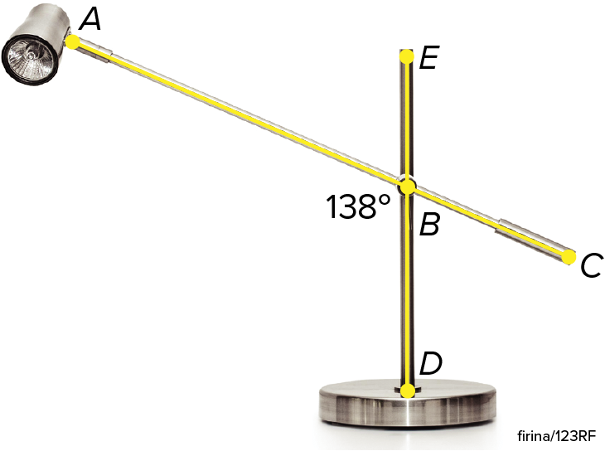
Example 3
Vertical Angles and Angle Pairs
HOME DECOR The office lamp is made using two intersecting metal bars.
a. How many pairs of adjacent angles do you see
in the figure? List two pairs.
b. Identify two pairs of vertical angles in the figure.
c. How many linear pairs do you see in the figure?
List each pair.
d. Find m∠EBC.
e. Find m∠ABE.

Slide 21
Example 3
Vertical Angles and Angle Pairs
a. How many pairs of adjacent angles do
you see in the figure? List two pairs.
4; ∠DBA and ∠ABE, ∠ABE and ∠EBC
b. Identify two pairs of vertical angles in the figure.
∠DBA and ∠EBC, ∠ABE and ∠CBD
c. How many linear pairs do you see in the
figure? List each pair.
4; ∠DBA and ∠ABE, ∠ABE and ∠EBC, ∠EBC and ∠CBD, ∠CBD and ∠DBA

Slide 22
Example 3
Vertical Angles and Angle Pairs
d. Find m∠EBC.
Because ∠ABD and ∠EBC are formed by intersecting line segments, they are vertical angles. Because vertical angles are congruent, m∠EBC is the same as m∠ABD, 138°.
e. Find m∠ABE.
Because ∠ABE and ∠ABD form a linear pair, their measures add to 180°. Thus, m∠ABE = 180° − m∠ABD = 180° − 138° = 42°.

Slide 23
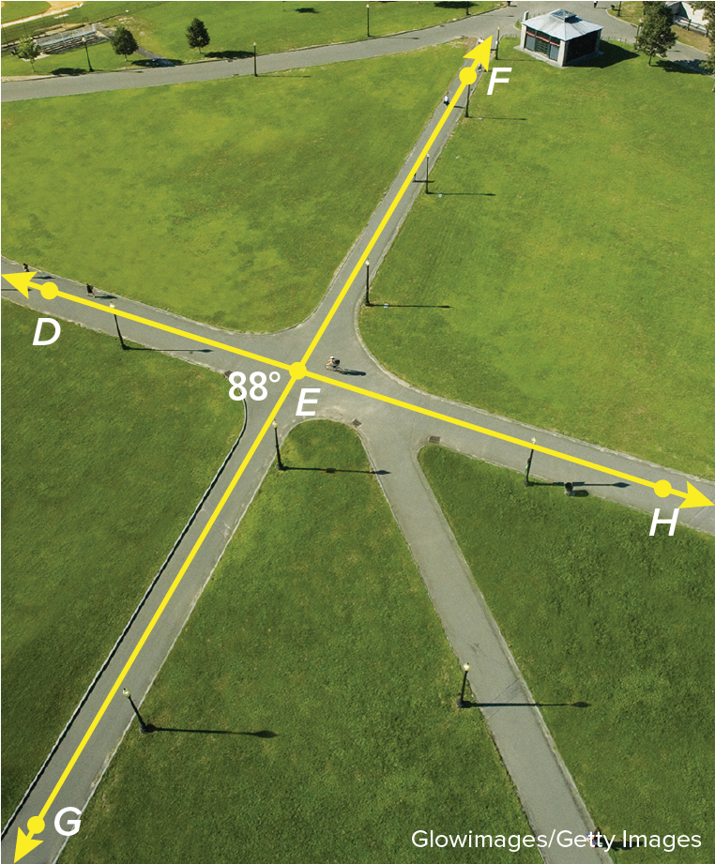
Example 3
Vertical Angles and Angle Pairs
Check
PARK A city planner is designing a park. He wants to place two pathways that intersect near the center of the park. If m∠GED = 88°, identify the true statement(s).
A. m∠DEF = 92°
B. m∠DEG = 92°
C. m∠FEH = 88°
D. m∠DEH = 92°
E. m∠GEH = 88°

Slide 24
Example 3
Vertical Angles and Angle Pairs
Check
PARK A city planner is designing a park. He wants to place two pathways that intersect near the center of the park. If m∠GED = 88°, identify the true statement(s). A, C
A. m∠DEF = 92°
B. m∠DEG = 92°
C. m∠FEH = 88°
D. m∠DEH = 92°
E. m∠GEH = 88°
Notes:
A, C

Slide 25
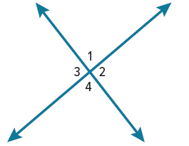
Exit Ticket
Use the figure.
1. ∠1 and what other angle(s) are vertical angles?
2. ∠2 and what other angle(s) are vertical angles?
3. ∠4 is adjacent to what other angle(s)?
4. ∠1 and what other angle(s) form a linear pair?
5. If m∠2 = 114°, then what are m∠1, m∠3, and m∠4?

Slide 26
Exit Ticket
Use the figure.
1. ∠1 and what other angle(s) are vertical angles?
2. ∠2 and what other angle(s) are vertical angles?
3. ∠4 is adjacent to what other angle(s)?
4. ∠1 and what other angle(s) form a linear pair?
5. If m∠2 = 114°, then what are m∠1, m∠3, and m∠4?
∠4
∠3
∠2 and ∠3
∠2 and ∠3
m∠1 = 66°, m∠3 = 114°, m∠4 = 66°
Notes:
∠4
∠3
∠2 and ∠3
∠2 and ∠3
m∠1 = 66°, m∠3 = 114°, m∠4 = 66°

