Slide 1






Line Segments

Slide 2
Lesson Objectives
Content Objective
Students will calculate measures of line segments.
Language Objectives
Students use negative and positive to talk about calculating measures of line segments.
To optimize output, students participate in MLR1: Stronger and Clearer Each Time.

Slide 3
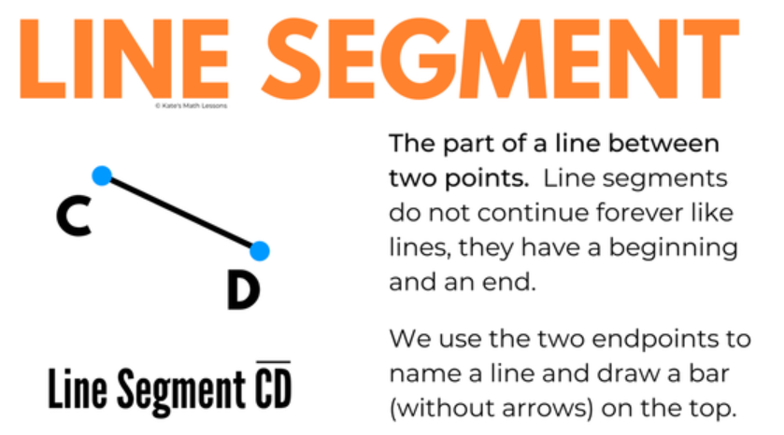






Learn
Betweenness of Points
A line segment is a measurable part of a line that consists of two points, called endpoints, and all of the points between them. The two endpoints are used to name the segment.

Slide 4



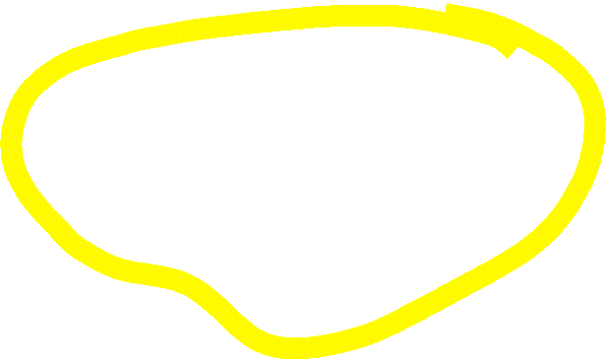

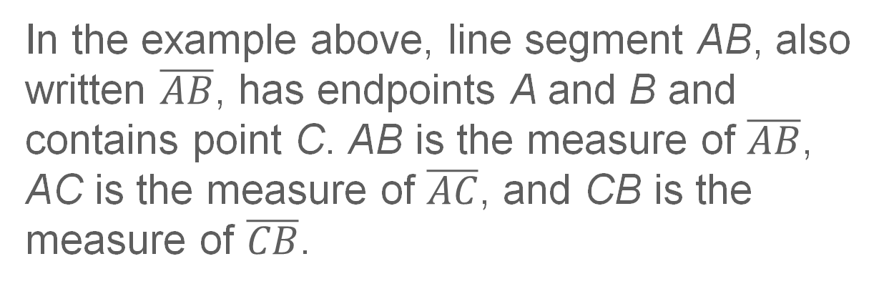
Learn
Betweenness of Points
Key Concept: Betweenness of Points
Point C is between A and B
if and only if A, B, and C are
collinear and AC + CB = AB.
In the example above, line segment AB, also written $\overline{AB}$, has endpoints A and B and contains point C. AB is the measure of $\overline{AB}$, AC is the measure of $\overline{AC}$, and CB is the measure of $\overline{CB}$.

Slide 5
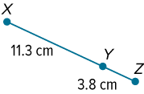




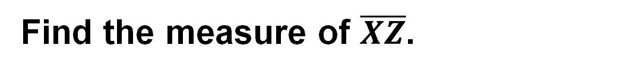





Example 1
Find Measurements by Adding
Find the measure of $\overline{XZ}$.

Slide 6
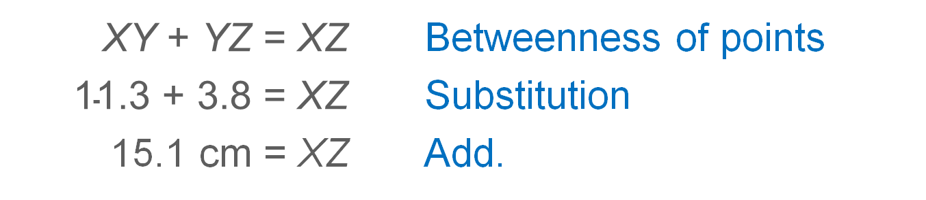
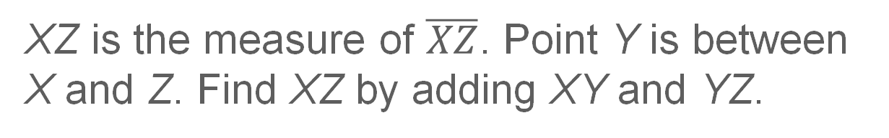
Example 1
Find Measurements by Adding
XZ is the measure of $\overline{XZ}$. Point Y is between X and Z. Find XZ by adding XY and YZ.
$$\text{XY} \text{+ }\text{YZ} \text{= }\text{XZ}$$ | Betweenness of points
$$\text{11.3}\text{ + 3.8 =} \text{XZ}$$ | Substitution
15.1 cm = XZ | Add.

Slide 7
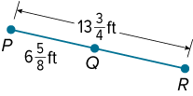
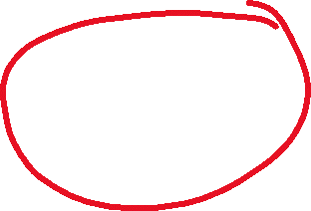













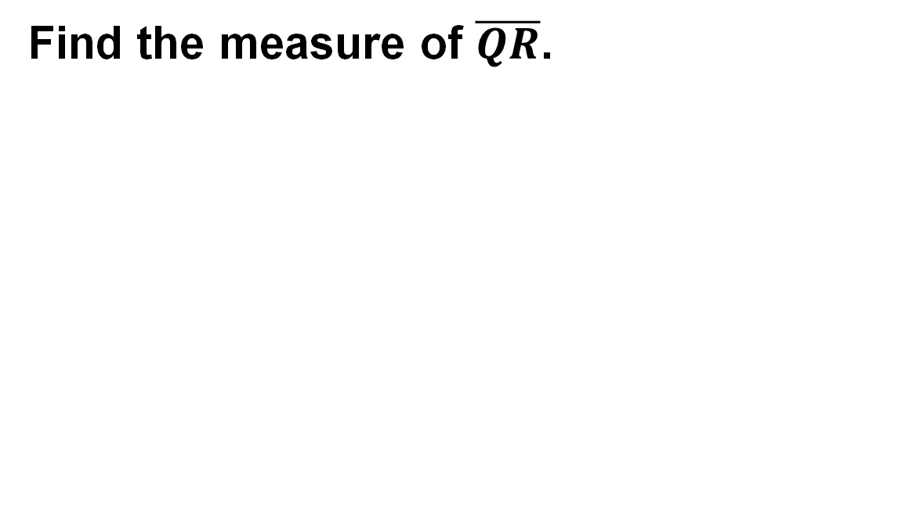




Example 2
Find Measurements by Subtracting
Find the measure of $\overline{QR}$.

Slide 8
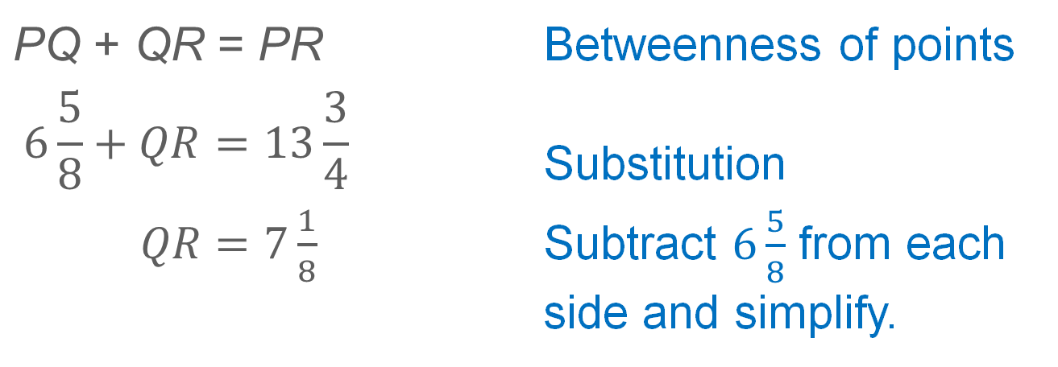
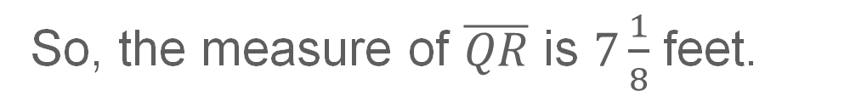
Example 2
Find Measurements by Subtracting
Point Q is between points P and R.
$$\text{PQ} \text{+ }\text{QR} \text{= }\text{PR}$$ | Betweenness of points
$$6\frac{5}{8}+QR=13\frac{3}{4}$$ | Substitution
$QR=7\frac{1}{8}$ | Subtract $6\frac{5}{8}$ from each side and simplify.
So, the measure of $\overline{QR}$ is $7\frac{1}{8}$ feet.

Slide 9






































































Example 3
Write and Solve Equations to Find Measurements
Find the value of x and BC if B is between A and C, AC = 4x − 12, AB = x, and BC = 2x + 3.

Slide 10

Example 3
Write and Solve Equations to Find Measurements
Step 1 Sketch two points and label them A and C. Connect the points.
Step 2 Sketch point B between points A and C.
Step 3 Label segments AB, BC, and AC with their given measures.

Slide 11



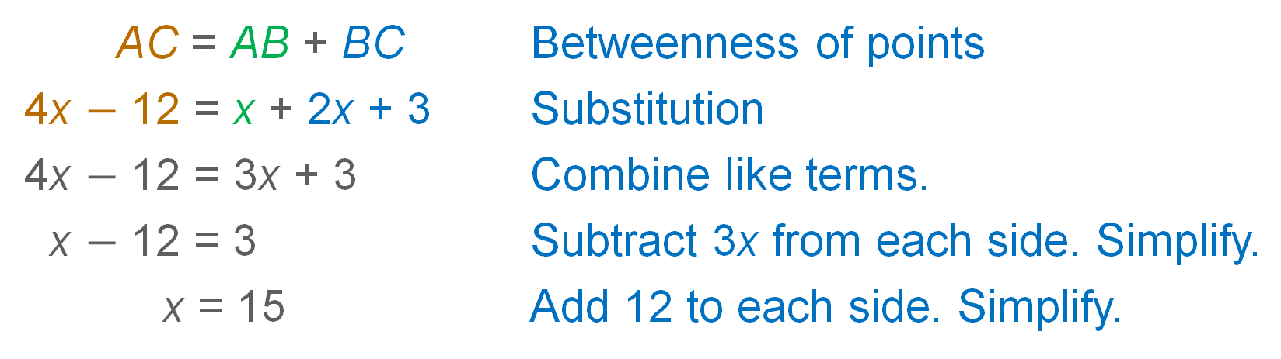
Example 3
Write and Solve Equations to Find Measurements
Step 4 Use betweenness of points to write an equation and solve for x.
AC = AB + BC | Betweenness of points
4x $−$ 12 = x + 2x + 3 | Substitution
4x $−$ 12 = 3x + 3 | Combine like terms.
x $−$ 12 = 3 | Subtract 3x from each side. Simplify.
x = 15 | Add 12 to each side. Simplify.

Slide 12




Learn
Line Segment Congruence
If two geometric figures have exactly the same shape and size, then they are congruent. Two segments that have the same measure are congruent segments.

Slide 13




Learn
Line Segment Congruence
Key Concept: Congruent Segments
≅ is read is congruent to. Tick marks on the figure also indicate congruence. Use a consecutive number of tick marks for each new pair of congruent segments in a figure.

Slide 14





Example 5
Write and Solve Equations by Using Congruence
Find the value of x.

Slide 15







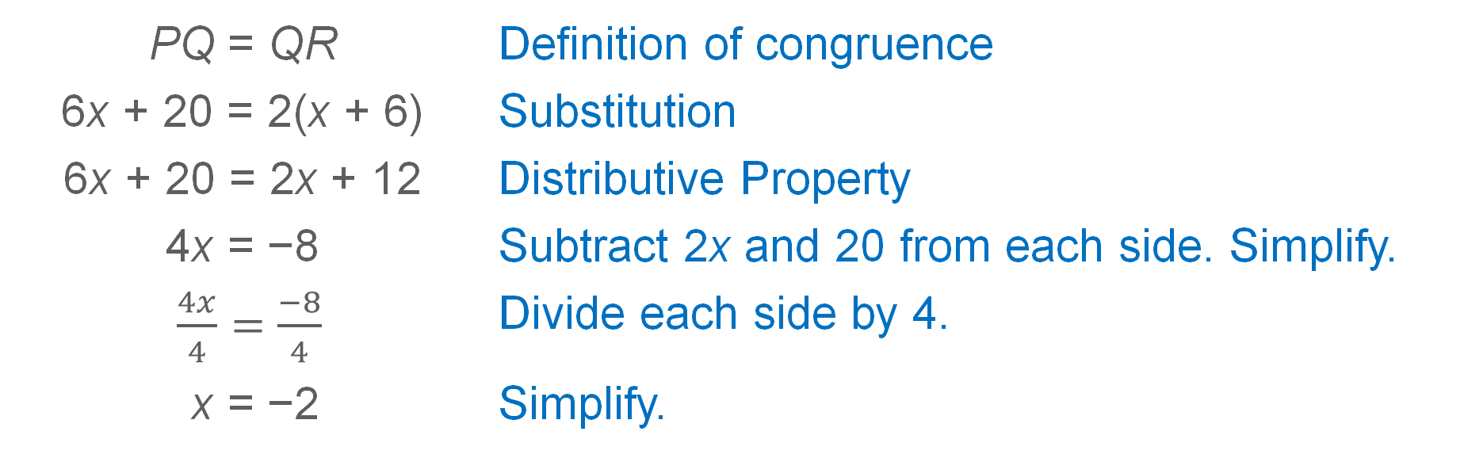





Example 5
Write and Solve Equations by Using Congruence
PQ = QR | Definition of congruence
6x + 20 = 2(x + 6) | Substitution
6x + 20 = 2x + 12 | Distributive Property
4x = −8 | Subtract 2x and 20 from each side. Simplify.
$\frac{4x}{4}=\frac{−8}{4}$ | Divide each side by 4.
x = −2 | Simplify.

