Slide 1
Points, Lines, and Planes

Slide 2
Florida’s B.E.S.T. Standards for Mathematics
MA.912.GR.1.1
Prove relationships and theorems about lines and
angles. Solve mathematical and real-world problems involving postulates, relationships and theorems of lines and angles.

Slide 3
Lesson Objectives
Content Objective
Students will analyze figures to identify points, lines, and planes and identify intersections of lines and planes.
Language Objectives
Students explain how to identify points, lines, and planes and identify intersections of lines and planes using can and cannot.
To cultivate conversation, students participate in MLR8: Discussion Supports.

Slide 4
Learn
Points, Lines, and Planes
Euclidean and Coordinate Geometry Terms
undefined terms | words, usually readily understood, that are not formally explained by means of more basic words and concepts
definition | an explanation that assigns properties to a mathematical object
defined term | a term that has a definition and can be explained using undefined terms and/or defined terms
postulate or axiom | a statement that is accepted as true without proof
theorem | a statement or conjecture that can be proven true using undefined terms, definitions, and postulates

Slide 5
Learn
Points, Lines, and Planes
In geometry, point, line, and plane are considered undefined terms because they are usually readily understood and are not formally explained by means of more basic words and concepts.
You may already be familiar with the terms point, line, and plane from algebra. In algebra, you graph on a coordinate plane and find ordered pairs that represent points on lines. In geometry, these terms have a similar meaning.

Slide 6

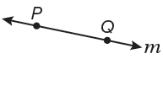
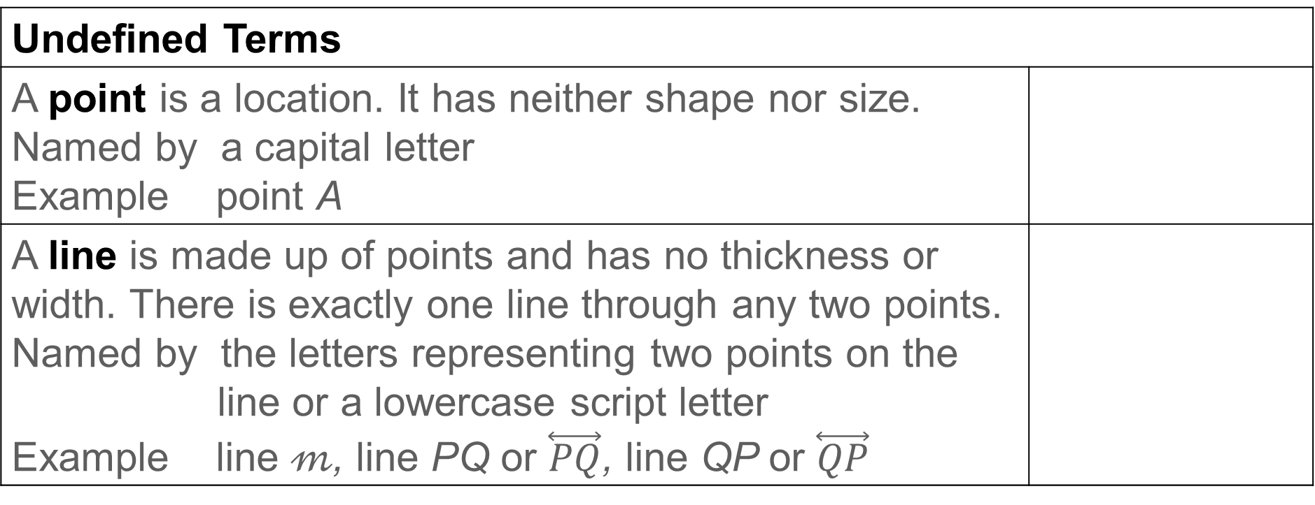
Learn
Points, Lines, and Planes
Undefined Terms
A point is a location. It has neither shape nor size. Named by a capital letter Example point A
A line is made up of points and has no thickness or width. There is exactly one line through any two points. Named by the letters representing two points on the line or a lowercase script letter Example line 𝓂, line PQ or $\overset{⃡}{PQ}$, line QP or $\overset{⃡}{QP}$

Slide 7
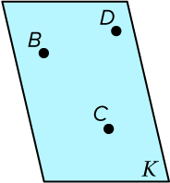
Learn
Points, Lines, and Planes
Undefined Terms
A plane is a flat surface made up of points that extends infinitely in all directions. There is exactly one plane through any three points not on the same line. Named by a capital script letter or by the letters naming three points that are not all on the same line Example plane 𝒦, plane BCD, plane CDB, plane DCB, plane DBC, plane CBD, plane BDC

Slide 8
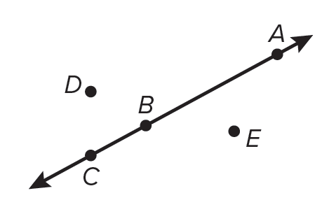
Learn
Points, Lines, and Planes
Space is defined as a boundless three-dimensional set of all points. Space can contain lines and planes. Collinear points are points that lie on the same line. Noncollinear points do not lie on the same line.
Points A, B, and C are collinear.

Slide 9
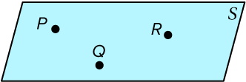
Learn
Points, Lines, and Planes
Coplanar points are points that lie in the same plane. Noncoplanar points do not lie in the same plane.
Points P, Q, and R are coplanar in plane 𝒮.

Slide 10
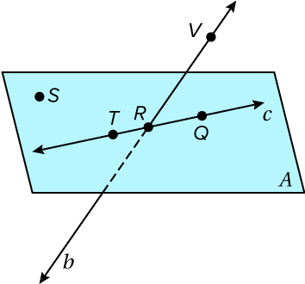
Example 1
Name Lines and Planes
Use the figure to name each of the following.
a. a line containing point Q
b. a plane containing point S and point T

Slide 11
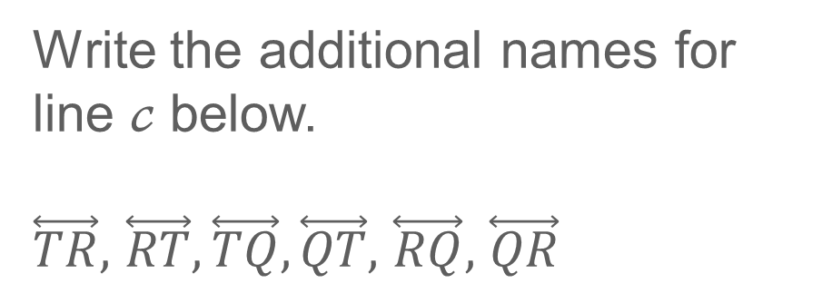
Example 1
Name Lines and Planes
a. a line containing point Q The line can be named as line 𝒸, or any two of the three points on the line can be used to name the line.
Write the additional names for line 𝒸 below.
$\overset{⃡}{TR},$ $\overset{⃡}{RT}, \overset{⃡}{TQ}, \overset{⃡}{QT},$ $\overset{⃡}{RQ},$ $\overset{⃡}{QR}$

Slide 12
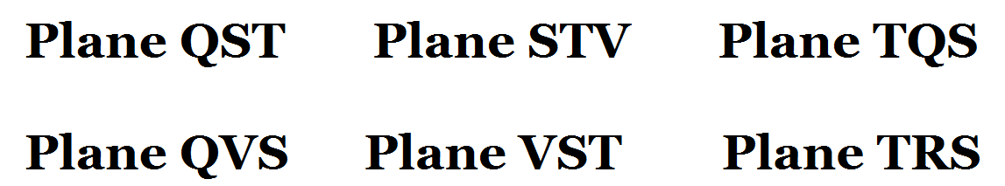
Example 1
Name Lines and Planes
b. a plane containing point S and point T One plane that can be named is plane 𝒜. You can also use the letters of any three noncollinear points to name this plane. Circle the other correct names for plane 𝒜. plane QST plane STV plane TQS plane QVS plane VST plane TRS

Slide 13
Example 1
Name Lines and Planes
b. a plane containing point S and point T One plane that can be named is plane 𝒜. You can also use the letters of any three noncollinear points to name this plane. Circle the other correct names for plane 𝒜. plane QST plane STV plane TQS plane QVS plane VST plane TRS

Slide 14
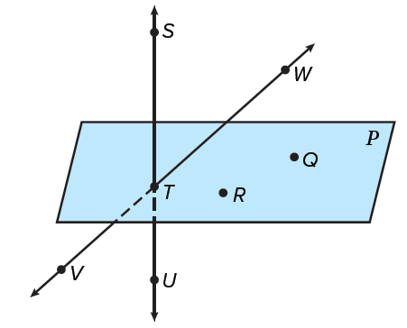
Example 1
Name Lines and Planes
Check
Use the figure to name each of the following.
a. Identify the correct names for a plane
containing point T.
plane RTQ plane VTW plane 𝒫
plane WST plane TQR plane WTV
b. a line containing point U

Slide 15




Example 1
Name Lines and Planes
Check
Use the figure to name each of the following.
a. Identify the correct names for a plane
containing point T.
plane RTQ plane VTW plane 𝒫
plane WST plane TQR plane WTV
b. a line containing point U
$\overset{⃡}{ST} \overset{⃡}{TS} \overset{⃡}{SU}$ $\overset{⃡}{US} \overset{⃡}{TU}$ $\overset{⃡}{UT}$
Notes:
plane RTQ, plane 𝒫, plane WST, plane TQR
$\overset{⃡}{ST} \overset{⃡}{TS} \overset{⃡}{SU}$ $\overset{⃡}{US} \overset{⃡}{TU}$ $\overset{⃡}{UT}$

Slide 16
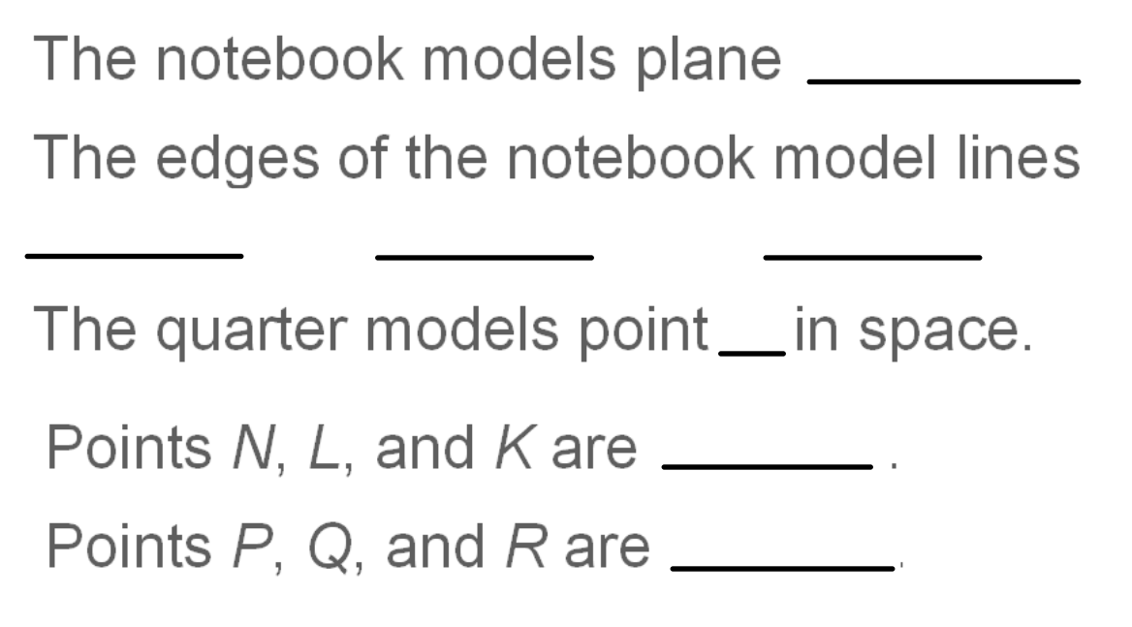
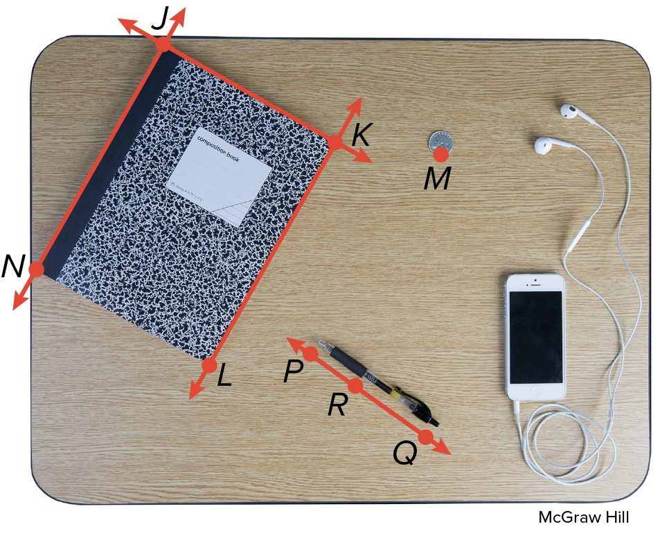
Example 2
Model Points, Lines, and Planes
The notebook models plane JKL or NJK.
The edges of the notebook model lines JK, KL, and JN.
The quarter models point M in space.
Points N, L, and K are coplanar.
Points P, Q, and R are collinear.

Slide 17





Example 2
Model Points, Lines, and Planes
The notebook models plane JKL or NJK.
The edges of the notebook model lines JK, KL, and JN.
The quarter models point M in space.
Points N, L, and K are coplanar.
Points P, Q, and R are collinear.

Slide 18
Learn
Intersections of Lines and Planes
The intersection of two or more geometric figures is the set of points they have in common. Two lines intersect in a point. Lines can intersect planes, and planes can intersect each other.
Two planes intersect at a _________.
A line and a plane intersect at a _________.

Slide 19

Learn
Intersections of Lines and Planes
The intersection of two or more geometric figures is the set of points they have in common. Two lines intersect in a point. Lines can intersect planes, and planes can intersect each other.
LINE
Two planes intersect at a _________.
A line and a plane intersect at a _________.
POINT

Slide 20
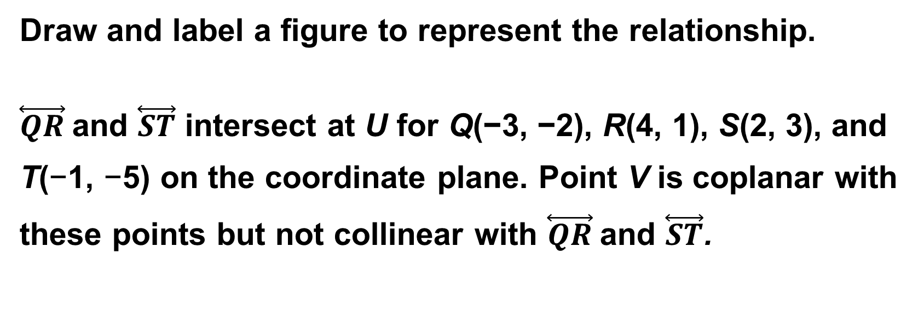
Example 3
Draw Geometric Figures
Draw and label a figure to represent the relationship.
$\overset{⃡}{QR}$and $\overset{⃡}{ST}$ intersect at U for Q(−3, −2), R(4, 1), S(2, 3), and
T(−1, −5) on the coordinate plane. Point V is coplanar with
these points but not collinear with $\overset{⃡}{QR}$and $\overset{⃡}{ST}$.

Slide 21
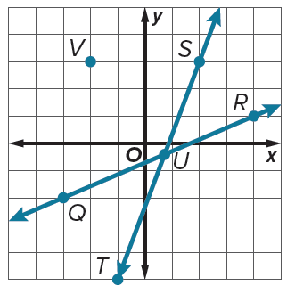
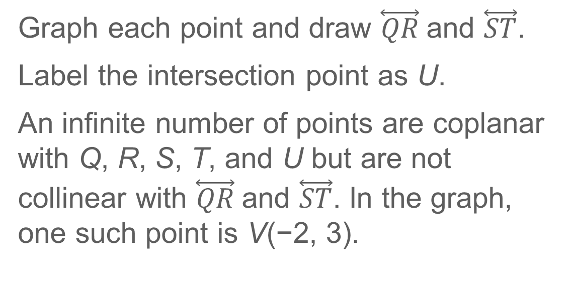
Example 3
Draw Geometric Figures
Graph each point and draw $\overset{⃡}{QR}$and $\overset{⃡}{ST}$.
Label the intersection point as U.
An infinite number of points are coplanar with Q, R, S, T, and U but are not collinear with $\overset{⃡}{QR}$and $\overset{⃡}{ST}$. In the graph, one such point is V(−2, 3).

Slide 22
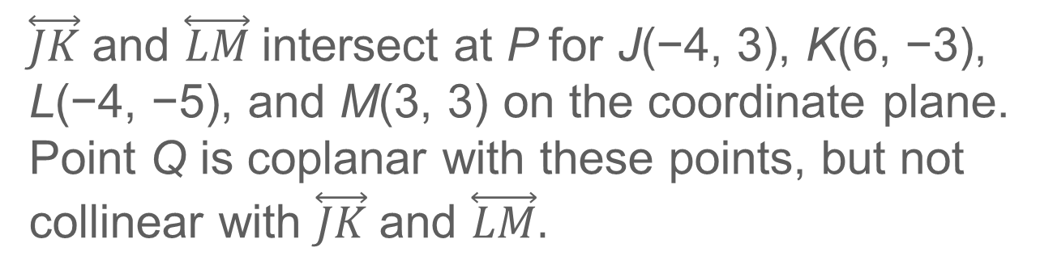
Example 3
Draw Geometric Figures
Check
Draw and label a figure to represent the relationship.
$\overset{⃡}{JK}$and $\overset{⃡}{LM}$intersect at P for J(−4, 3), K(6, −3), L(−4, −5), and M(3, 3) on the coordinate plane. Point Q is coplanar with these points, but not collinear with $\overset{⃡}{JK}$and $\overset{⃡}{LM}.$

Slide 23
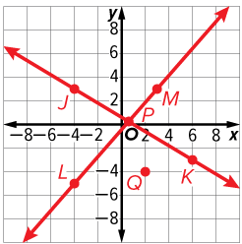
Example 3
Draw Geometric Figures
Check
Draw and label a figure to represent the relationship.
$\overset{⃡}{JK}$and $\overset{⃡}{LM}$intersect at P for J(−4, 3), K(6, −3), L(−4, −5), and M(3, 3) on the coordinate plane. Point Q is coplanar with these points, but not collinear with $\overset{⃡}{JK}$and $\overset{⃡}{LM}.$

Slide 24
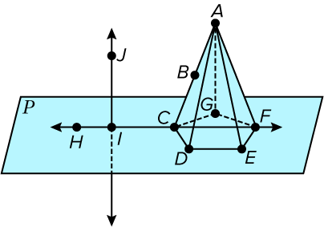
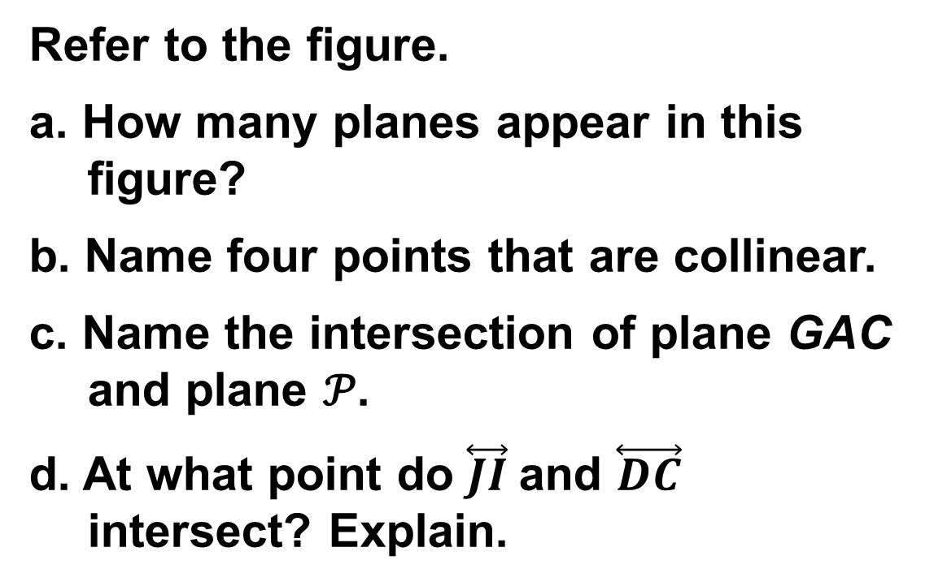
Example 4
Interpret Drawings
Refer to the figure.
a. How many planes appear in this figure?
b. Name four points that are collinear.
c. Name the intersection of plane GAC and plane 𝒫.
d. At what point do $\overset{⃡}{JI}$and $\overset{⃡}{DC}$ intersect? Explain.

Slide 25
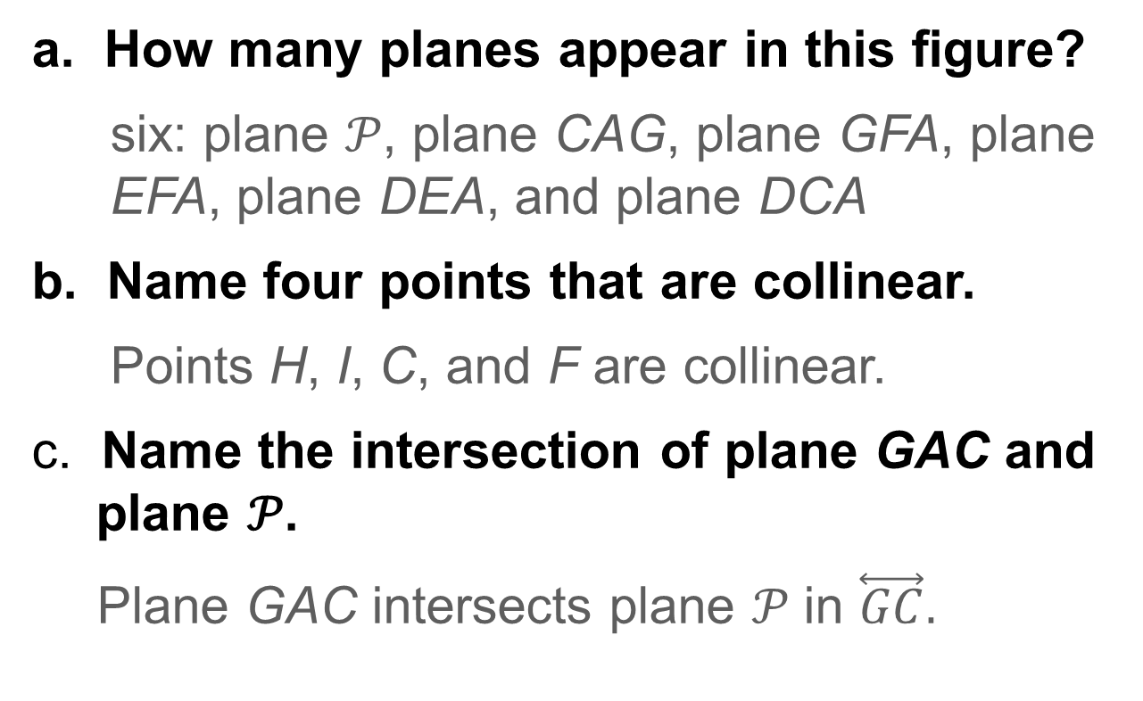
Example 4
Interpret Drawings
a. How many planes appear in this figure?
six: plane 𝒫, plane CAG, plane GFA, plane EFA, plane DEA, and plane DCA
Name four points that are collinear.
Points H, I, C, and F are collinear.
c. Name the intersection of plane GAC and plane 𝒫.
Plane GAC intersects plane 𝒫 in $\overset{⃡}{GC}.$

Slide 26
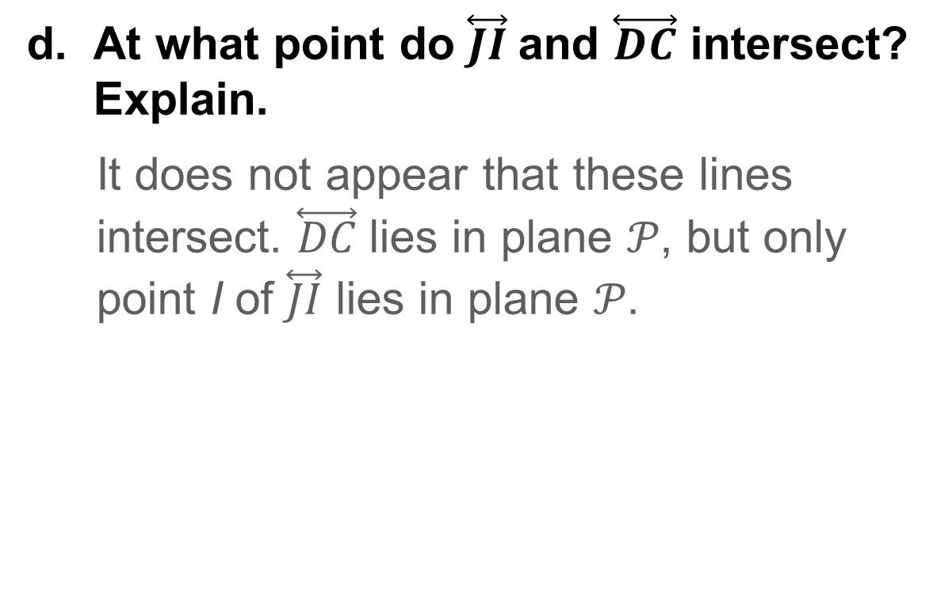
Example 4
Interpret Drawings
At what point do $\overset{⃡}{JI}$and $\overset{⃡}{DC}$ intersect? Explain.
It does not appear that these lines intersect. $\overset{⃡}{DC}$lies in plane 𝒫, but only point I of $\overset{⃡}{JI}$ lies in plane 𝒫.

Slide 27
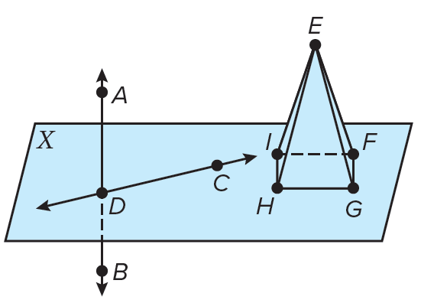
Example 4
Interpret Drawings
Check
Refer to the figure. Name three points that are collinear.

Slide 28
Example 4
Interpret Drawings
Check
Refer to the figure. Name three points that are collinear.
Points D, A, and B are collinear.
Notes:
Points D, A, and B are collinear.

