Slide 1

Preparing for the
RHS College FaiR
Wed, Sept 25
Subtitle
Notes:
NOTE:
To change the image on this slide, select the picture and delete it. Then click the Pictures icon in the placeholder to insert your own image.

Slide 2


Be Prepared & Make a Plan
View the list of schools attending here
Research schools
Make a list of schools you want to speak with
https://www.mycollegeresource.net/preparing-for-a-college-fair

Slide 3
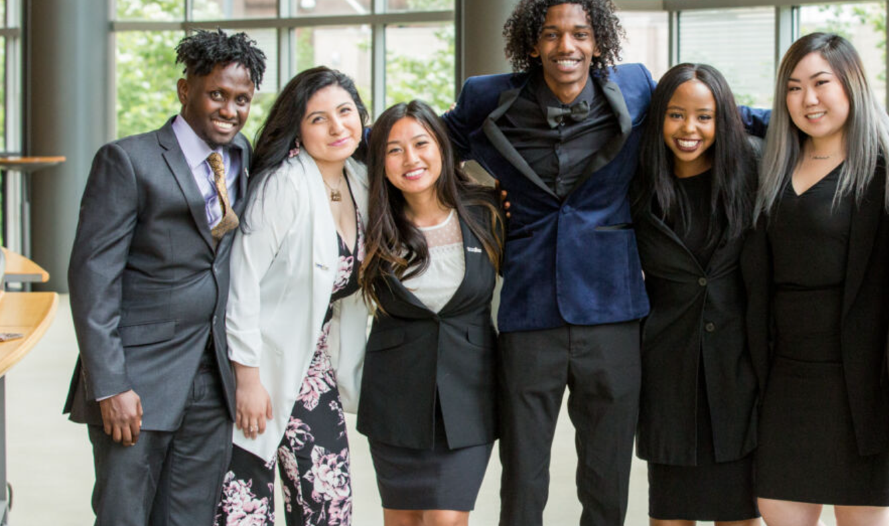
Look the Part: Dress & Act Professionally
Dress nicely
Practice acting like a student who is ready for college
If the rep offers you swag, thank them & take only ONE

Slide 4

Present Yourself as a College Candidate
Shake hands with each rep
Introduce yourself
Make eye contact

Slide 5

Be Ready To Talk About Yourself
  Reps want to know:
  Favorite classes or subjects
  Extracurricular activities
  Career plans (at this point)
  Current GPA
  Why you are interested in their school

Slide 6

Ask Questions
Prepare questions related to:
The school
Your academic interests
Your extracurricular interests

Slide 7
Get Contact Info & Follow Up
Get a business card
Send a follow up email (from your personal email) thanking the rep for talking with you
Send follow up emails once per quarter or semester with updates on…
  What you are accomplishing
  How your interests have changed or developed
  Further questions about the school

Slide 8
Questions To Ask at a College Fair
ACADEMICS
What academic programs are the most popular at your college?
How would you describe the academic pressure and workload?
How does my major differ at your college, compared to other colleges/universities?
Are there internships available specific to my major?

Slide 9
Questions To Ask at a College Fair
CAMPUS LIFE
What % of students live on campus?
What is a typical Friday or Saturday night at your school?
How often do students go off campus on the weekends?
How would you describe a typical student at your school?
What do students like least about campus life? What is a common complaint?

Slide 10
Questions To Ask at a College Fair
ADMISSIONS & ALUMNI
What are the most important aspects that admissions officers consider in deciding who to accept?
Who are your favorite famous alumni from your school?
How does your career planning department compare to other colleges/universities?
Are there student representatives that I can talk to about their experience at your school?

