Slide 1


Healthy Coping Strategies: Building a Resilient You

Slide 2


Slide 3

What is Resilience?

Slide 4
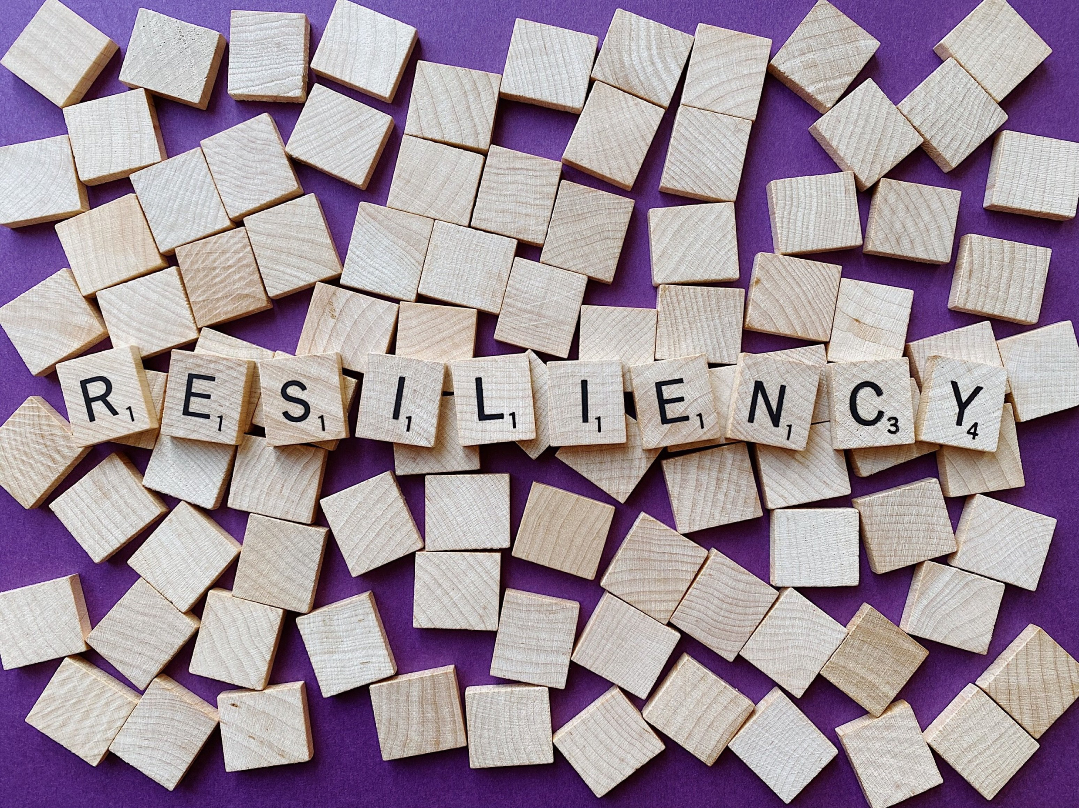
Notes:
What is resiliency?

Slide 5
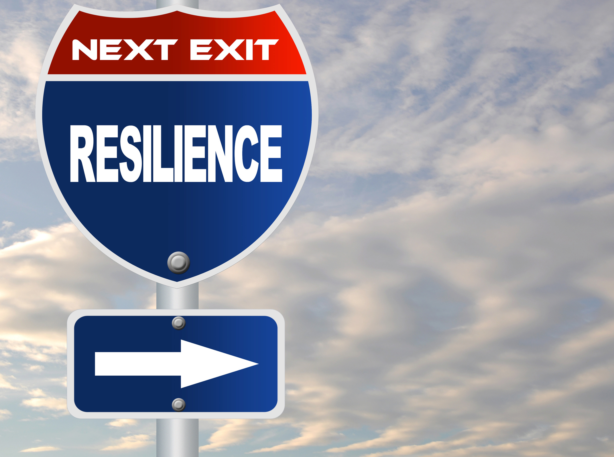
Resiliency isn’t a personality trait that only some people possess.
Resilience involves behaviors, thoughts and actions that anyone can learn and develop.

Slide 6

4 Components to Building Resilience
  Build Your Connections
  Foster Wellness
  Find Purpose
  Embrace Healthy Thoughts

Slide 7

Build Your Connections
  Prioritize Relationships
  Join a Group
  Look to Family and Friends for Support

Slide 8
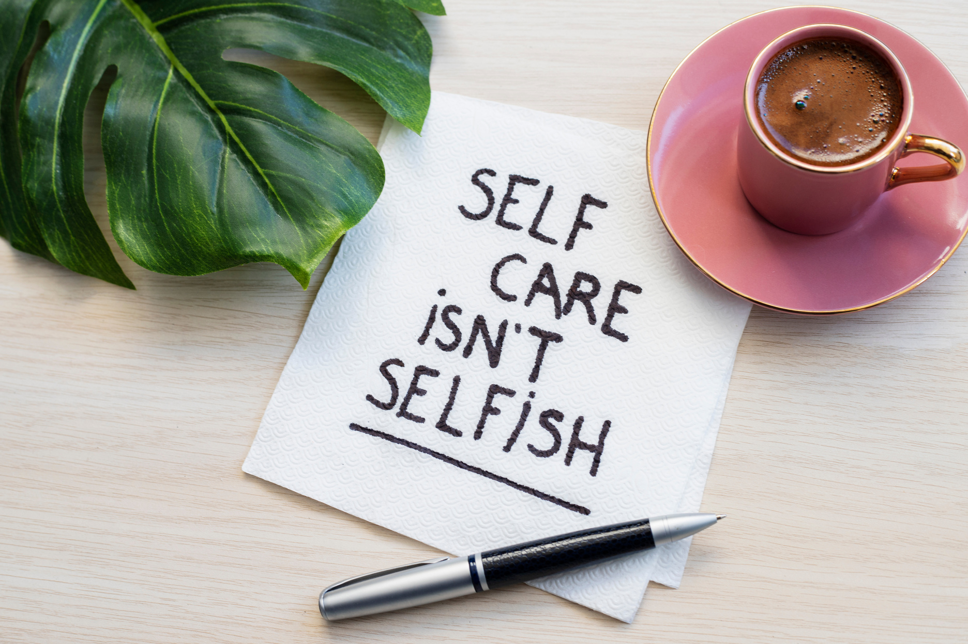
Foster Wellness
  Take Care of Your Body
  Practice Mindfulness
  Avoid Negative Outlets

Slide 9

Find Purpose
  Help Others
  Be Proactive
  Move Toward Your Goals
  Look for Opportunities for Self Discovery

Slide 10

Embrace Healthy Thoughts
  Keep Things in Perspective
  Accept Change
  Maintain a Hopeful Outlook
  Learn From the Past

Slide 11

Seek Help When Needed
Asking for help is a sign of strength, not weakness. Reach out to trusted friends, family members, or professionals when facing challenges.

Slide 12

Resiliency
Challenge

Slide 13

Building Connections
Fostering Wellness
Finding Purpose
Embrace Healthy Thoughts

Slide 14

Build Your Connections –
Say “hi” to someone in the halls
Invite someone new to sit at your lunch table
Text 3 friends and tell them how important they are to you.
Ask a friend that you haven’t hung out with in a while to go do something.
Come up with your own idea!

Slide 15

Foster Wellness
Treat yourself to that coffee or that new t-shirt
Take a new exercise class
Spend some time outside relaxing.
Listen to music
Go to the beach
Ask for help

Slide 16

Find Purpose
Volunteer at an animal shelter
Ask your teacher or parent if they need help with a project
Reflect on what is your why?
Tackle a problem by breaking it into manageable parts
Make a goal for the day, the week or even a month
Listen to a podcast or program and learn something new

Slide 17
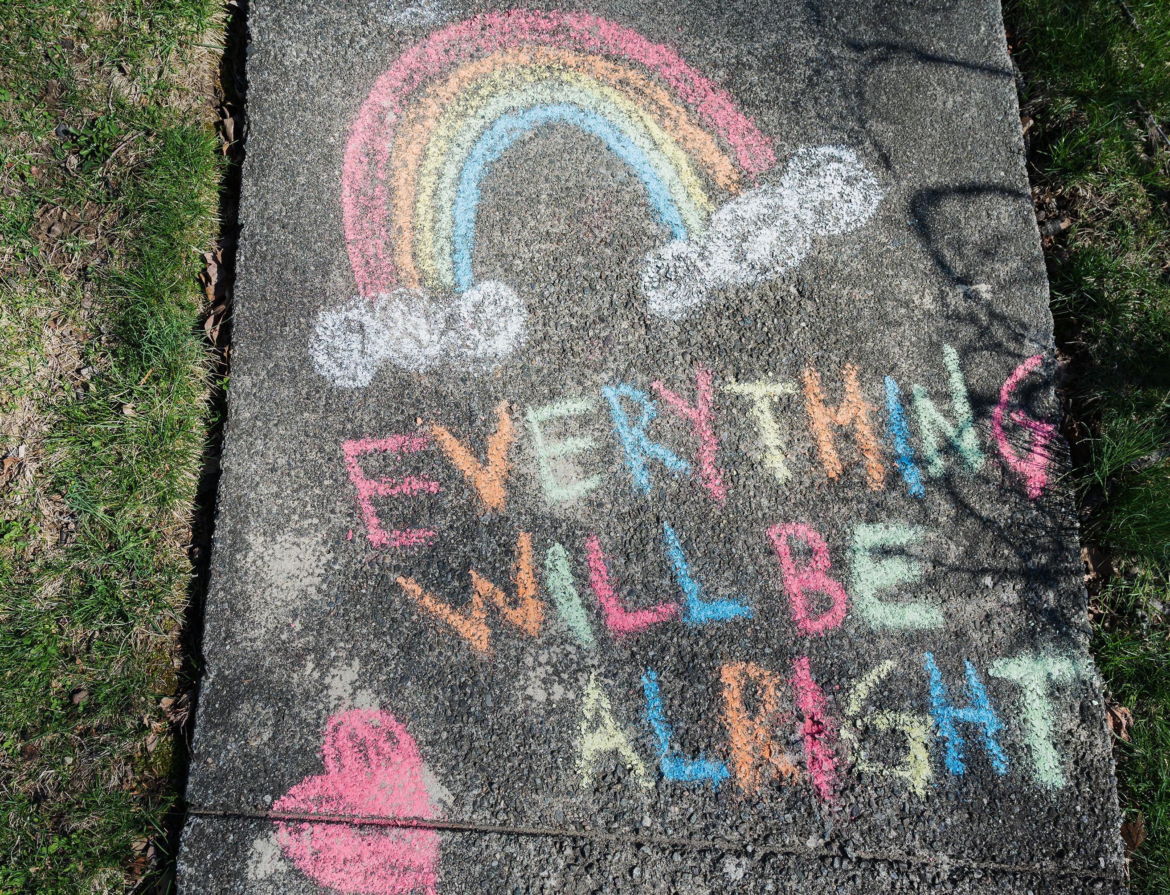
Embrace Healthy Thoughts
Keep a gratitude journal for a week
Forgive yourself for mistakes, everyone makes them
Try to visualize what you want, rather than worrying about what your fear
Accept change with a positive idea

Slide 18
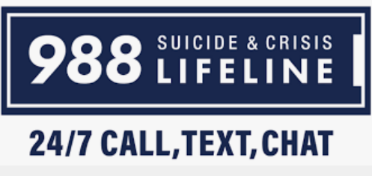

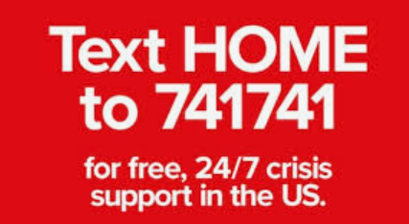

Resources
Suicide and Crisis Hotline – Call 988
Text 211 – Here to help hotline
Crisis Text Line - Text “Home” to 781-781
Hope For Healing Florida – www.Hopeforhealingfl.com
Name of school counselors at our school:
INSERT NAMES HERE

Slide 19
Thank you for your attention and participation.
It matters and is appreciated!
Thank you teachers for your support!

