Slide 1
Constructions
With a Compass, Straightedge, and Patty Paper
Copy a Segment
Copy an Angle
Perpendicular Bisector of a Segment
Bisect an Angle

Slide 2
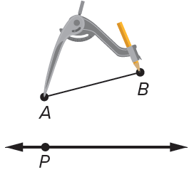
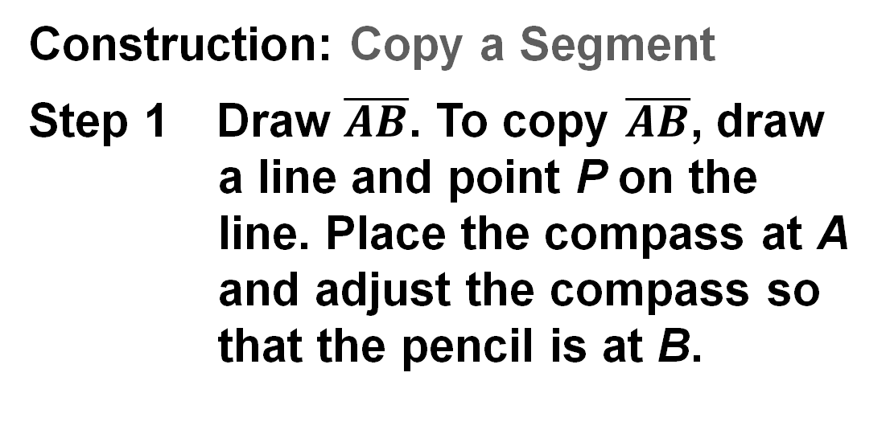
Learn
Line Segment Congruence
https://www.mathopenref.com/constcopysegment.html
You can construct a segment that is congruent to a given segment.
Construction: Copy a Segment
Step 1 Draw $\overline{AB}$. To copy $\overline{AB}$, draw a line and point P on the line. Place the compass at A and adjust the compass so that the pencil is at B.

Slide 3
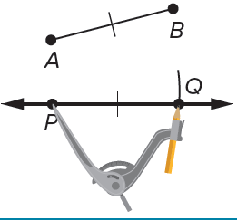
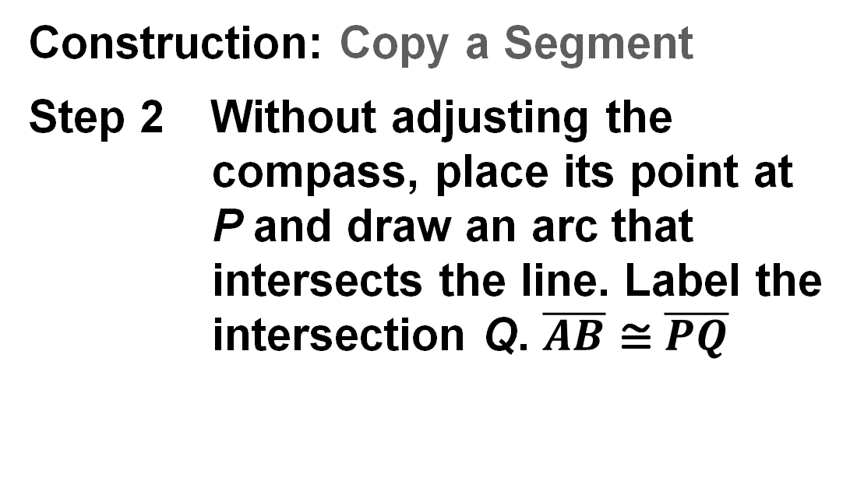
Learn
Line Segment Congruence
Construction: Copy a Segment
Step 2 Without adjusting the compass, place its point at P and draw an arc that intersects the line. Label the intersection Q. $\overline{AB}$ ≅ $\overline{PQ}$

Slide 4
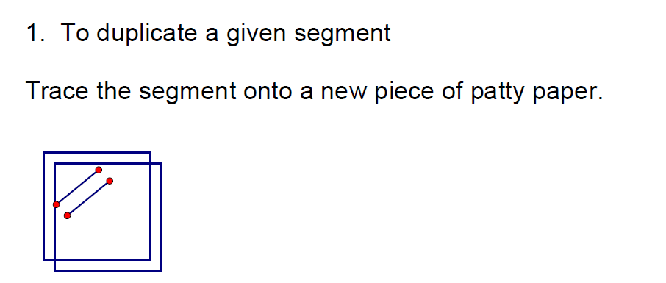

Slide 5
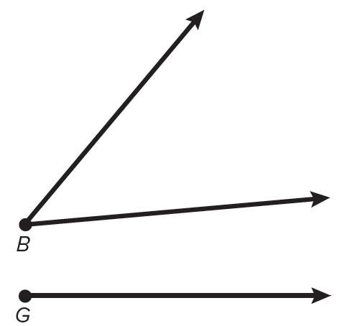
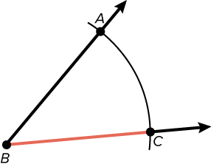
Learn
Congruent Angles
https://www.mathopenref.com/constcopyangle.html
Construction: Copy an Angle
STEP 1 You are given ∠B. Use a straightedge to draw a ray on your paper. Label its endpoint G.
STEP 2 Place the thumbtack at the vertex of ∠B and draw a large arc that intersects both sides of ∠B. Label the points of intersection A and C.

Slide 6
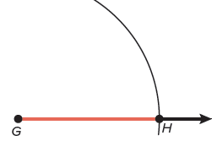
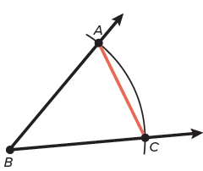
Learn
Congruent Angles
Construction: Copy an Angle
STEP 3 Without changing the length of the string, place the thumbtack on G and draw an arc that starts above the ray and intersects the ray. Label the point of intersection H.
STEP 4 Place the thumbtack on C and adjust your string so that the pencil tip is on A.

Slide 7
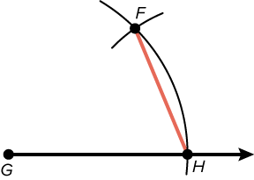
Learn
Congruent Angles
Construction: Copy an Angle
STEP 5 Without changing the length of the string, place the thumbtack on H and draw an arc to intersect the larger arc you drew in Step 3. Label the point of intersection F.

Slide 8
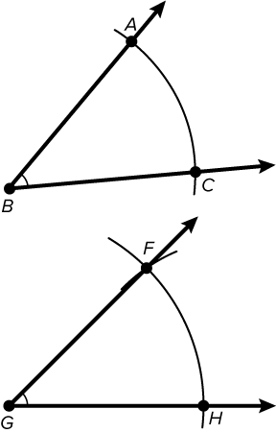
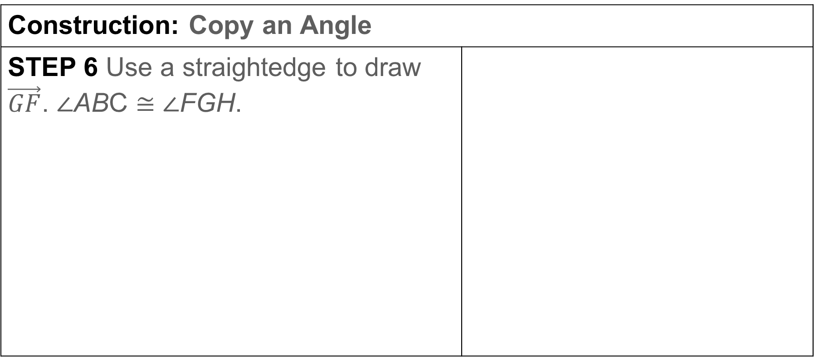
Learn
Congruent Angles
Construction: Copy an Angle
STEP 6 Use a straightedge to draw $\vec{GF}$. ∠ABC ≅ ∠FGH.

Slide 9
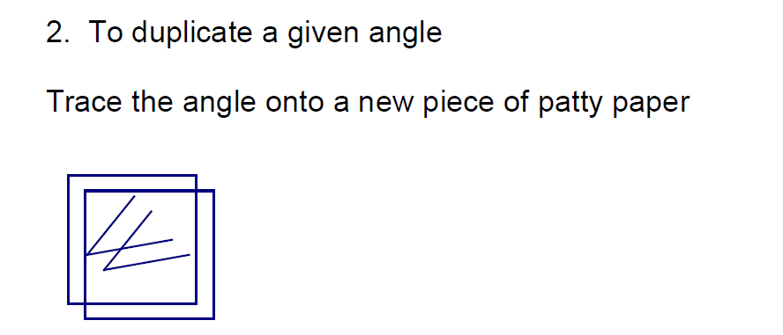

Slide 10
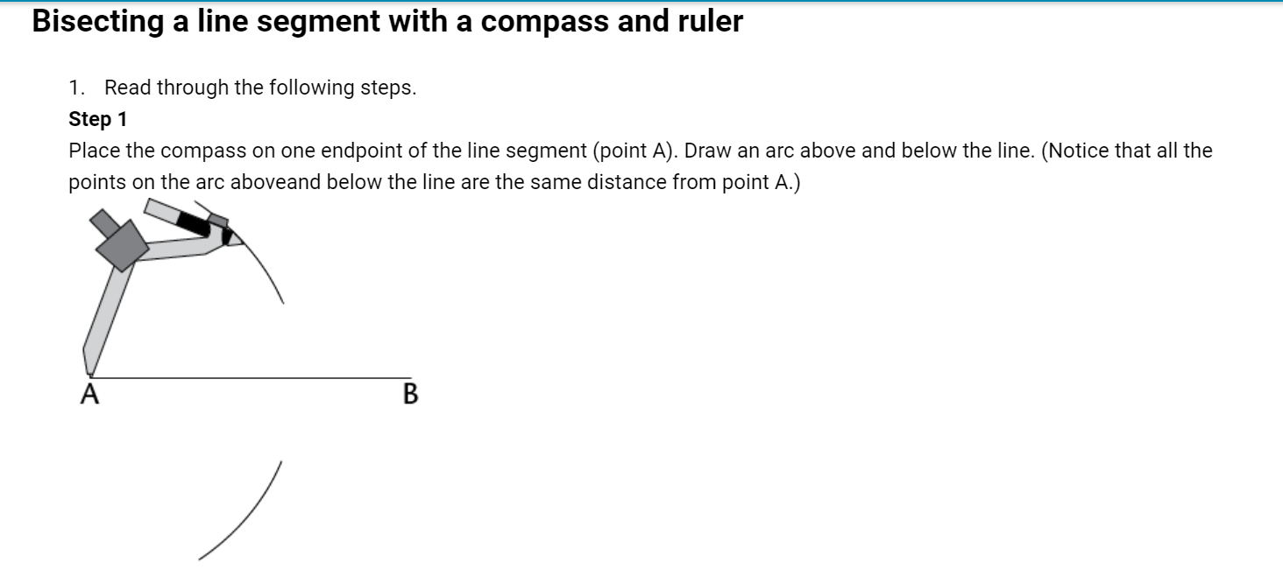
https://www.mathopenref.com/constbisectline.html

Slide 11
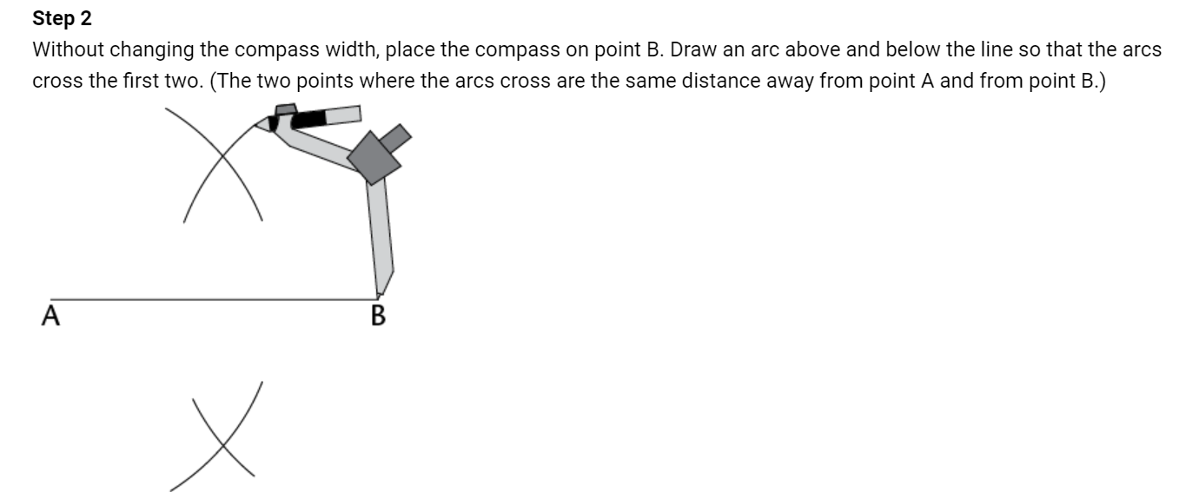

Slide 12
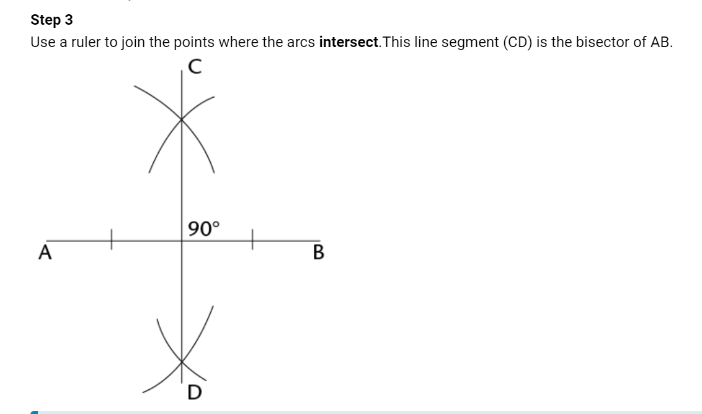

Slide 13
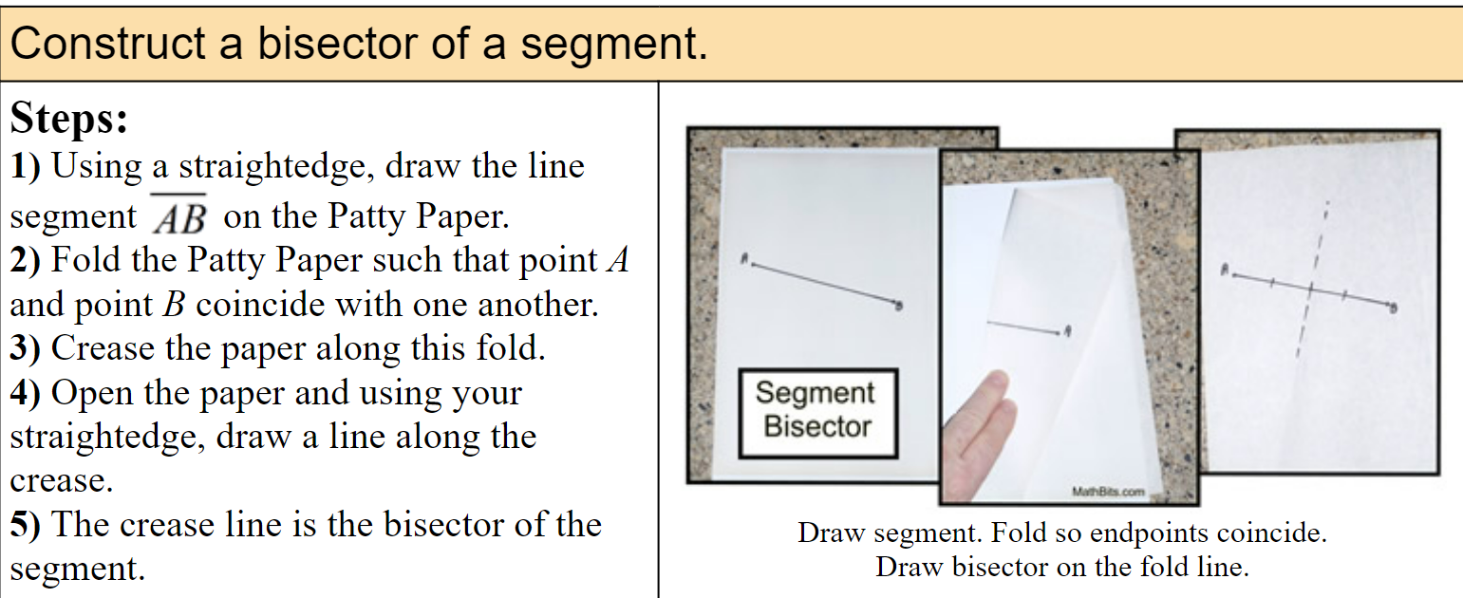

Slide 14
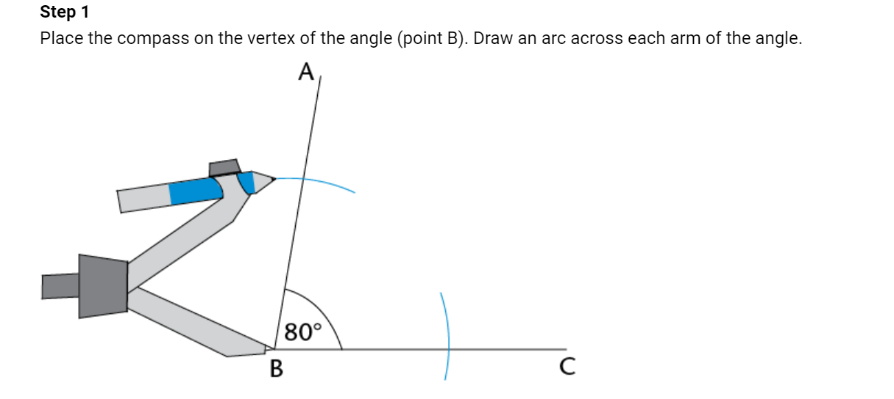
https://www.mathopenref.com/constbisectangle.html
Construction of an Angle Bisector

Slide 15
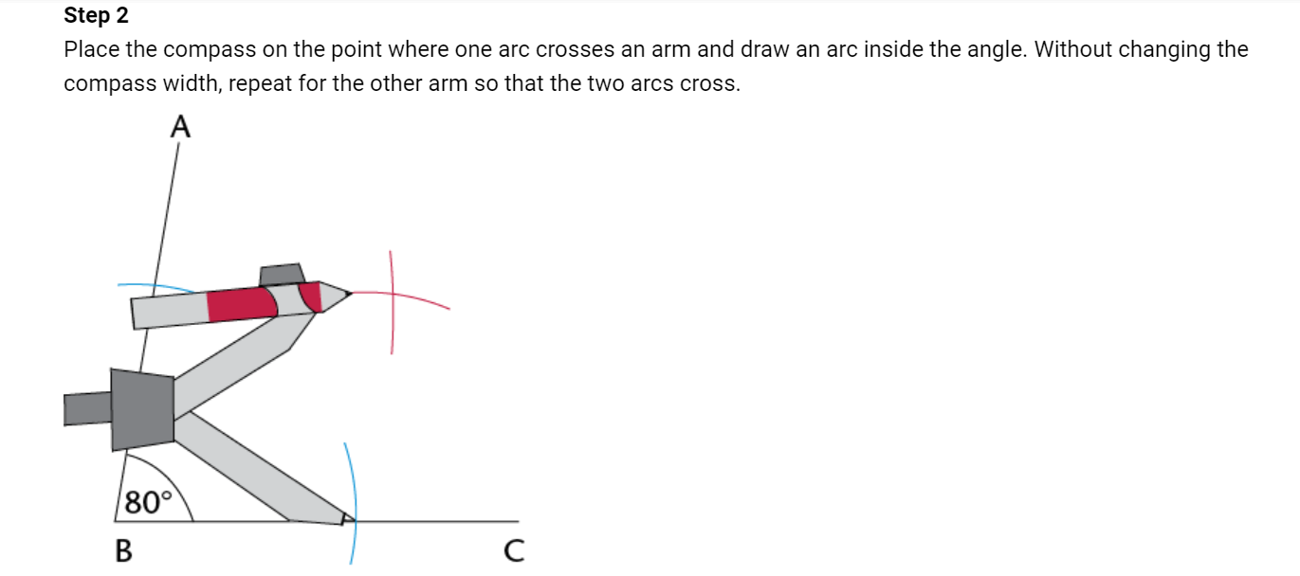

Slide 16
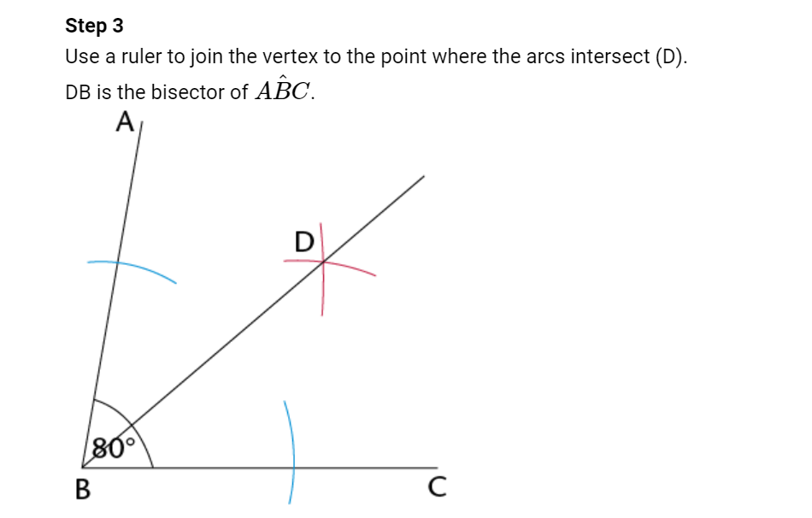

Slide 17
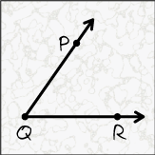
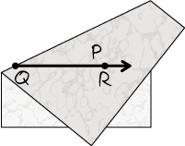
Learn
Congruent Angles
Construction: Bisect an Angle
STEP 1 Draw ∠PQR on a sheet of tracing paper.
STEP 2 Fold the paper until the two rays of the angle overlap. Then crease the paper. Unfold the paper.

Slide 18
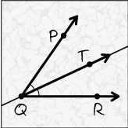
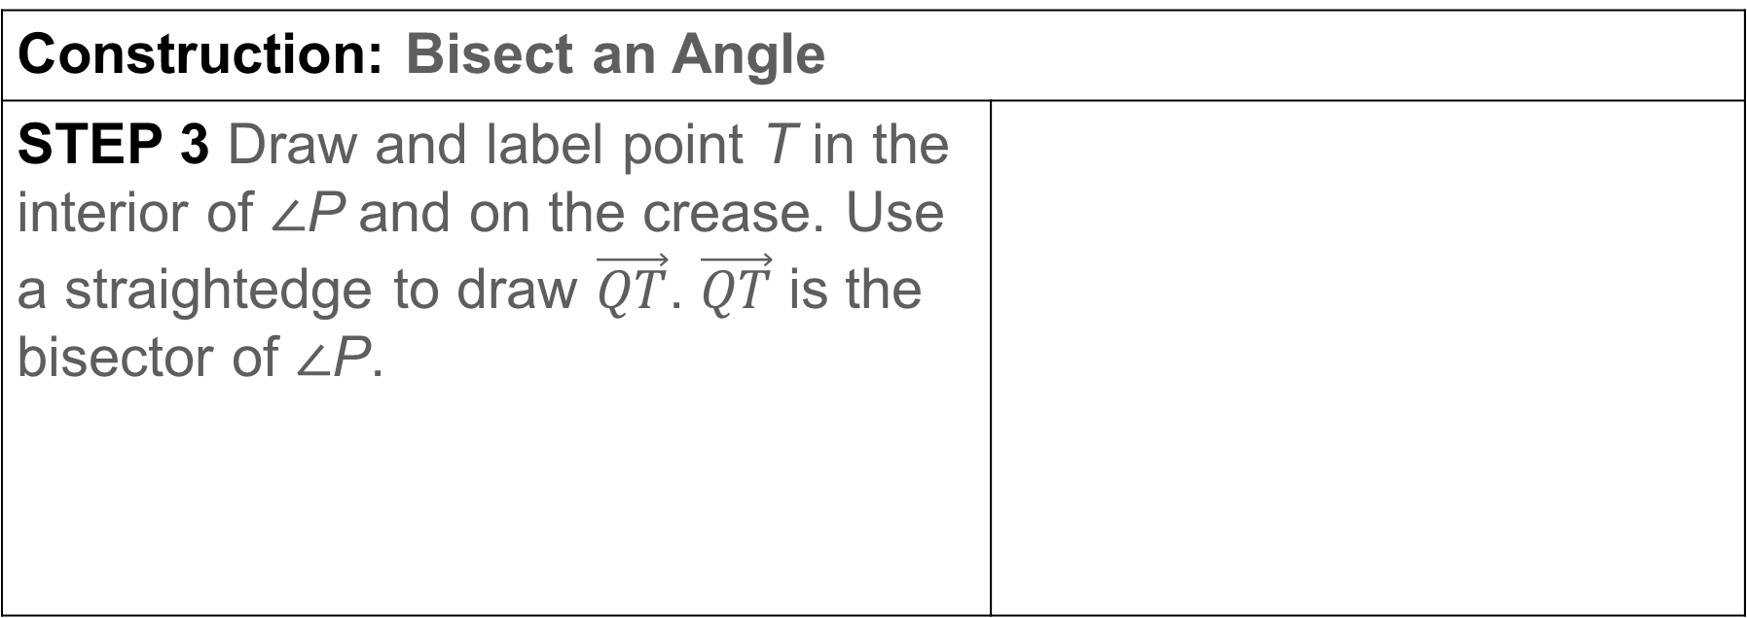
Learn
Congruent Angles
Construction: Bisect an Angle
STEP 3 Draw and label point T in the interior of ∠P and on the crease. Use a straightedge to draw $\vec{QT}$. $\vec{QT}$ is the bisector of ∠P.

