Slide 1
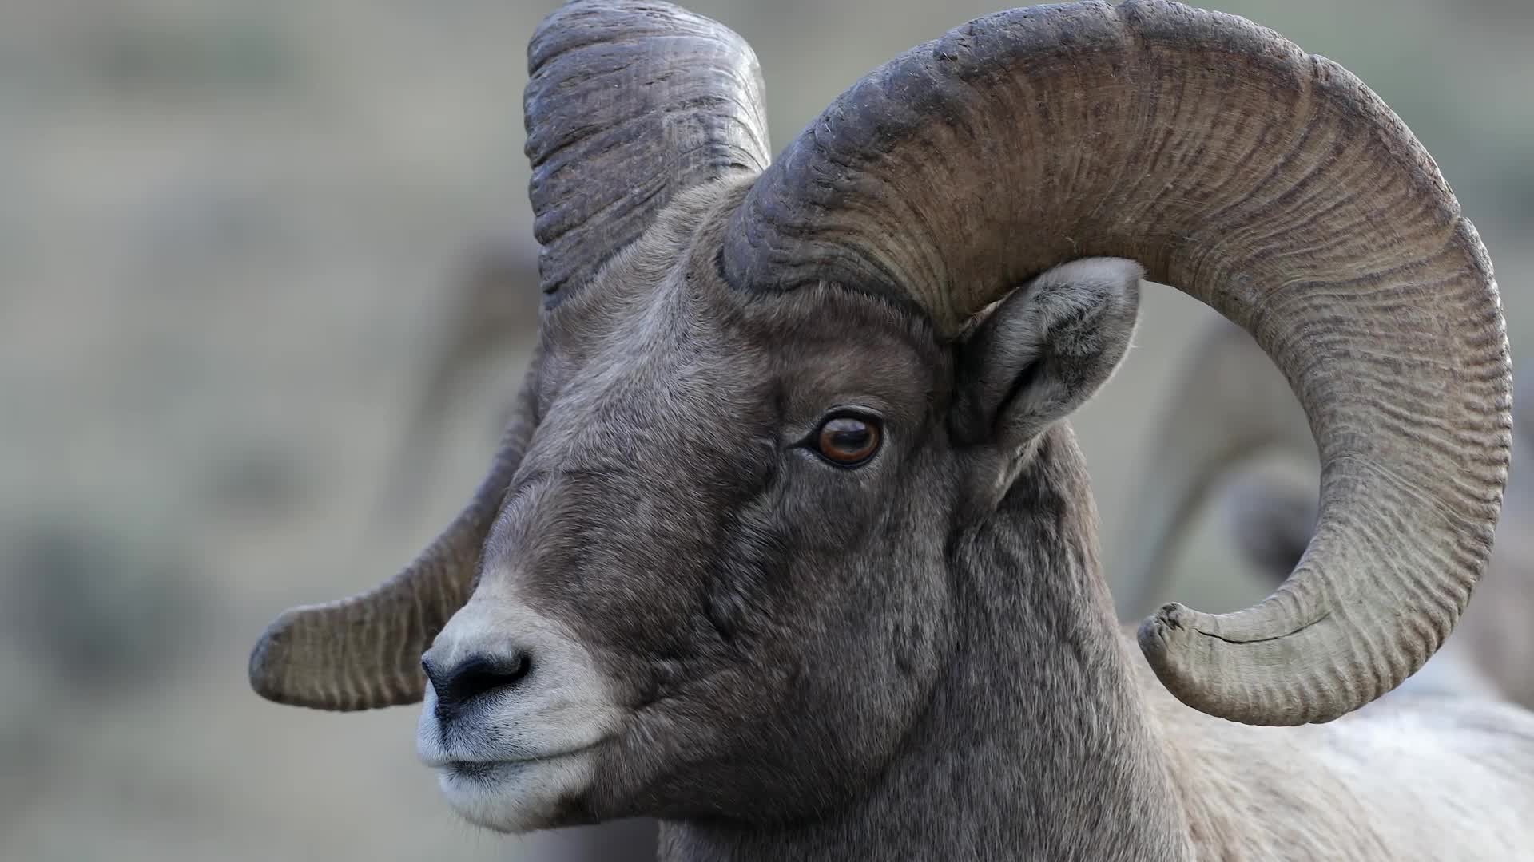
Ram 4: Responsibility
PBIS Lesson 2
Respectful Responsible Ready Resilient

Slide 2
Lesson 2: Learning Intention
Effectively Identify Appropriate Behaviors in each area of RAM4
Create a Chart/Visual to hang outside each classroom that states what RESPONSIBLITY “Looks Like” or “Sounds Like” at school and with friends.

Slide 3
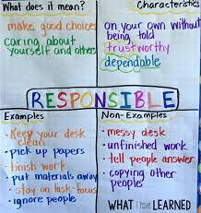
Material and Instructions
Large Chart Paper- Located in Each Teacher Planning Room and use any markers, sticky notes & any other creative elements you want to add.
You can create anything you like that is visually appealing and includes the trait RESPONSIBILITY!
  You are free to design this activity however fits best for your classroom (You do not need to follow the examples exactly!)
Please include RAM 4 on your lesson & the RAM 4 trait: RESPONSIBLE or RESPONSIBILITY
Complete this with any class period and post outside your classroom door in the hallway by December 2nd!

Slide 4
Examples for Students
Examples in School
Staying off cell phone when needed
Being wise on social media during day
Have materials for class
Do work in class/homework on time
Accepting consequences for what we say or do
Don’t make excuses
Developing to our full potential
Examples with Friends
Honoring a commitment
Not breaking a promise
Voice of reason during a tough situation
Being wise on Social media

Slide 5
Questions?
Please contact the PBIS team if you have any questions, concerns, or suggestions for how to improve this system!
Erin del Castillo
Ashley Hernandez
Jay Lorenz
Jennifer Eastman-Miller
Chad Smith
Jessica Bies
John Douglas
Tina Asadorian
Ciara Van Ness
Jeff Harris
Paige Taber
Justin Martin
Joe Bazenas

