Slide 1
Conjectures and Counterexamples

Slide 2
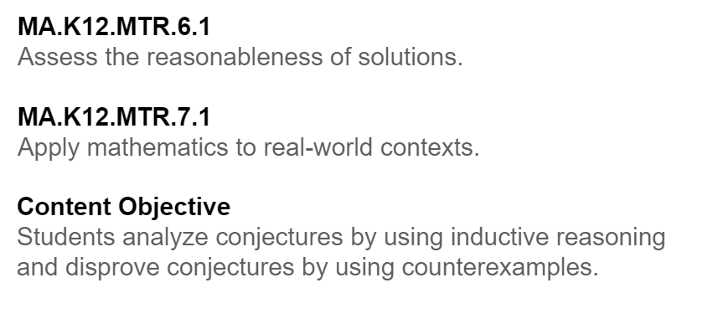
Florida’s B.E.S.T. Standards for Mathematics
MA.912.LT.4.10
Judge the validity of arguments and give
counterexamples to disprove statements.

Slide 3
Learn
Inductive Reasoning and Conjecture
Inductive reasoning is the process of reaching a conclusion based on a pattern of examples. When you assume that an observed pattern will continue, you are applying inductive reasoning. You can use inductive reasoning to make an educated guess based on known information and specific examples. This educated guess is also known as a conjecture.

Slide 4

Example 1
Patterns and Conjectures
Write a conjecture that describes the pattern in the sequence. Then use your conjecture to find the next term in the sequence.
Appointment times: 8:30 a.m., 9:15 a.m., 10:00 a.m., 10:45 a.m., . . .

Slide 5

Example 1
Patterns and Conjectures
Step 1 Look for a pattern.
Step 2 Make a conjecture.
Each appointment time is 45 minutes after the previous appointment time. The next appointment time will be 10:45 a.m. + 0:45 or 11:30 a.m.

Slide 6

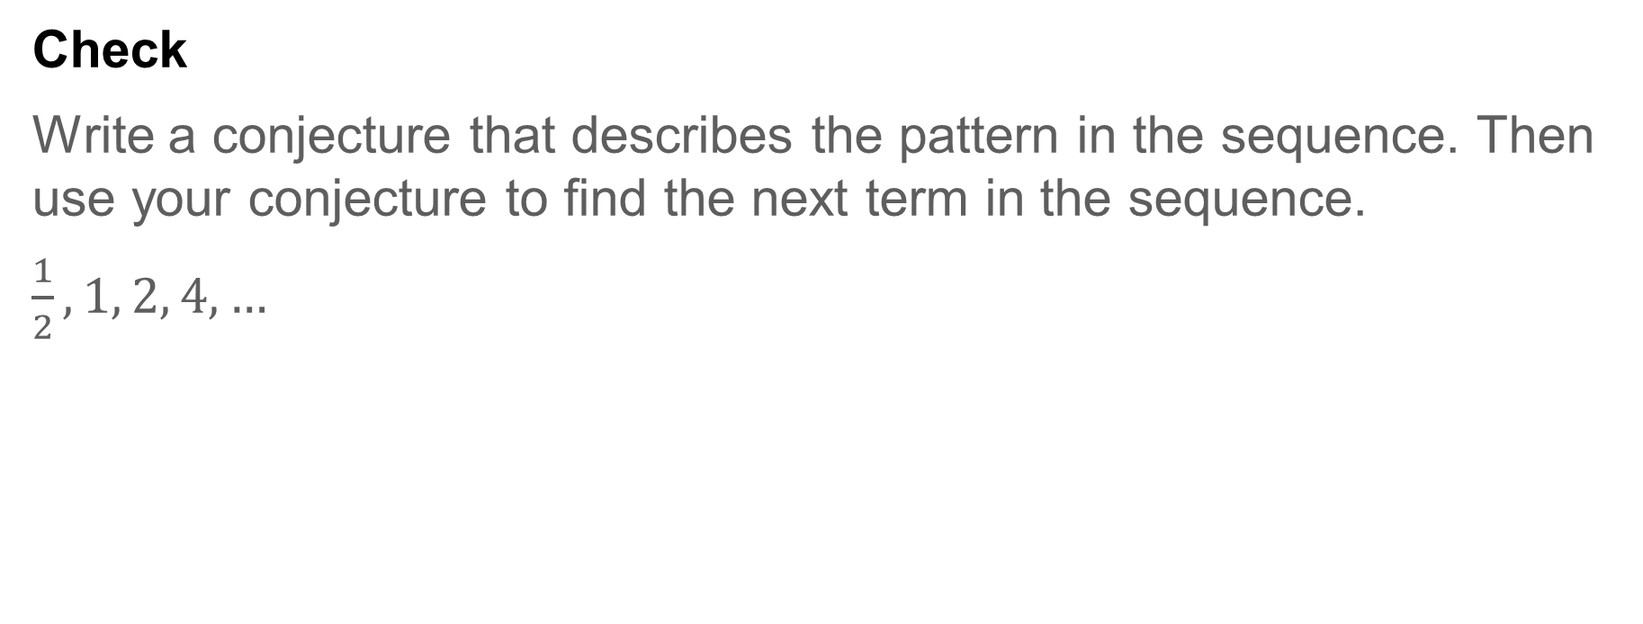
Example 1
Patterns and Conjectures
Check
Write a conjecture that describes the pattern in the sequence. Then use your conjecture to find the next term in the sequence.
$\frac{1}{2}, 1, 2, 4, …$

Slide 7
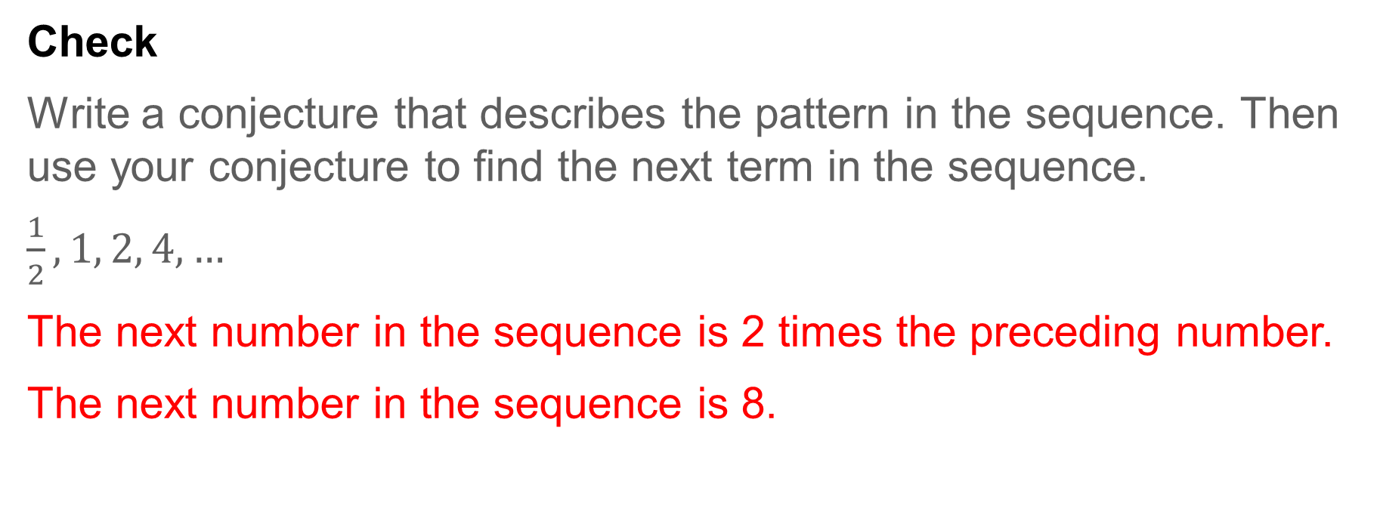
Example 1
Patterns and Conjectures
Check
Write a conjecture that describes the pattern in the sequence. Then use your conjecture to find the next term in the sequence.
$\frac{1}{2}, 1, 2, 4, …$
The next number in the sequence is 2 times the preceding number.
The next number in the sequence is 8.
Notes:
The next number in the sequence is 2 times the preceding number.
The next number in the sequence is 8.

Slide 8

Example 2
Algebraic Conjectures
Make a conjecture about the sum of the squares of two consecutive natural numbers. List or draw some examples that support your conjecture.

Slide 9
Example 2
Algebraic Conjectures
Step 1 List examples.
1² + 2² = 5 6² + 7² = 85
2² + 3² = 13 10² + 11² = 221
Step 2 Look for a pattern.
Notice that all the sums are odd numbers.
Step 3 Make a conjecture.
The sum of the squares of two consecutive natural numbers is an odd number.

Slide 10

Example 2
Algebraic Conjectures
Check
Make a conjecture about the sum of two odd numbers.

Slide 11
Example 2
Algebraic Conjectures
Check
Make a conjecture about the sum of two odd numbers.
The sum of two odd numbers is always an even number.
Notes:
The sum of two odd numbers is always an even number.

Slide 12

Example 3
Geometric Conjectures
Make a conjecture about the relationship between the segments joining opposite vertices of isosceles trapezoids.

Slide 13
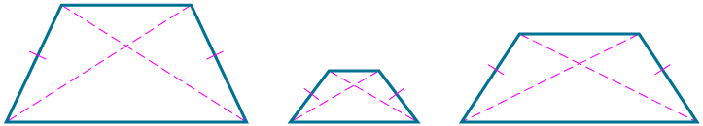
Example 3
Geometric Conjectures
Step 1 Draw several examples.
An isosceles trapezoid is a trapezoid with two opposite congruent legs.

Slide 14
Example 3
Geometric Conjectures
Step 2 Look for a pattern.
Notice that the segments joining opposite vertices of each isosceles trapezoid appear to have the same measure. Use a ruler or compass to confirm this.
Step 3 Make a conjecture.
The segments joining opposite vertices of an isosceles trapezoid are congruent.

Slide 15

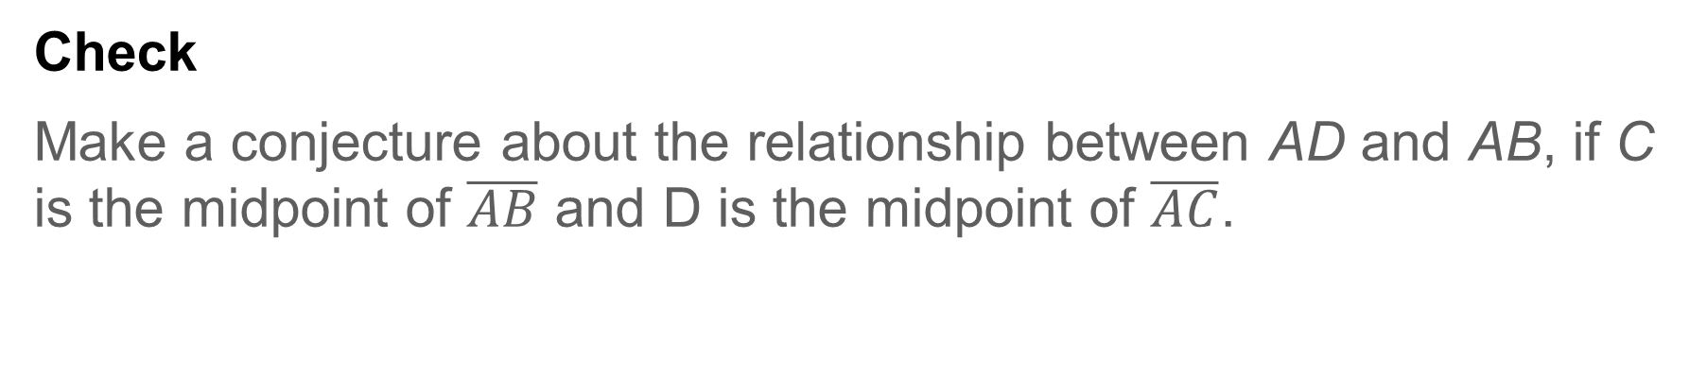
Example 3
Geometric Conjectures
Check
Make a conjecture about the relationship between AD and AB, if C is the midpoint of $\overline{AB}$ and D is the midpoint of $\overline{AC}$.

Slide 16
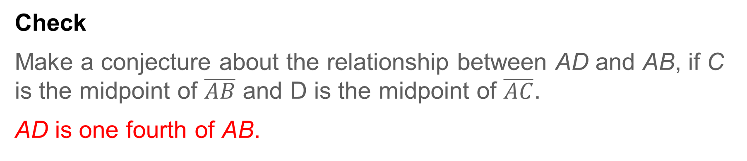
Example 3
Geometric Conjectures
Check
Make a conjecture about the relationship between AD and AB, if C is the midpoint of $\overline{AB}$ and D is the midpoint of $\overline{AC}$.
AD is one fourth of AB.
Notes:
AD is one fourth of AB.

Slide 17

Example 4
Make Conjectures from Data
GAS PRICES The table shows the average price of gasoline in the United States for the years 2010 through 2018. Make a conjecture about the price of gas in 2019. Explain how this conjecture is supported by the data given.
Year | Price (dollars per gallon)
2010 | 2.84
2011 | 3.58
2012 | 3.68
2013 | 3.58
2014 | 3.44
2015 | 2.43
2016 | 2.14
2017 | 2.42
2018 | 2.84

Slide 18
Example 4
Make Conjectures from Data
Look for patterns in the data.
The price of gasoline increased from 2010 to 2012. From 2012 to 2016, the price of gas decreased, at first at a steady rate, and then more dramatically. Beginning in 2017, the price of gas began to increase at a steady rate.
Year | Price (dollars per gallon)
2010 | 2.84
2011 | 3.58
2012 | 3.68
2013 | 3.58
2014 | 3.44
2015 | 2.43
2016 | 2.14
2017 | 2.42
2018 | 2.84

Slide 19
Example 4
Make Conjectures from Data
The data shows that the price of gas follows an oscillating pattern, increasing in price for several years before decreasing in price for several years.
Conjecture: In 2019, the price of gas will continue to increase.
Year | Price (dollars per gallon)
2010 | 2.84
2011 | 3.58
2012 | 3.68
2013 | 3.58
2014 | 3.44
2015 | 2.43
2016 | 2.14
2017 | 2.42
2018 | 2.84

Slide 20

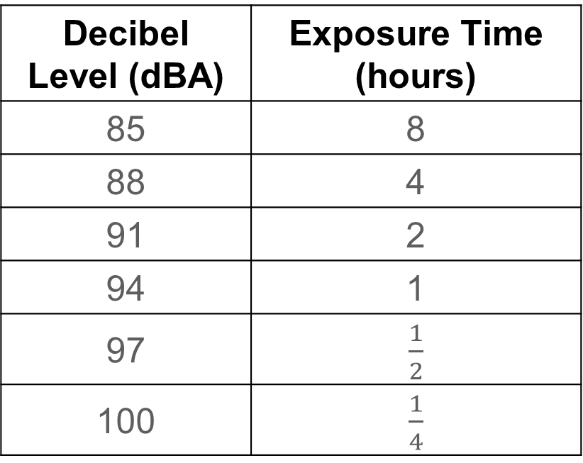
Example 4
Make Conjectures from Data
Check
HEARING LOSS The intensity of a sound to the human ear is measured in A-weighted decibels, or dBA. For every 3 decibels over 85 decibels, the exposure time it takes to cause hearing damage is cut in half. How long does it take to cause hearing damage at 106 decibels? Write your answer as a decimal.
Decibel Level (dBA) | Exposure Time (hours)
85 | 8
88 | 4
91 | 2
94 | 1
97 | $\frac{1}{2}$
100 | $\frac{1}{4}$

Slide 21
Example 4
Make Conjectures from Data
Check
HEARING LOSS The intensity of a sound to the human ear is measured in A-weighted decibels, or dBA. For every 3 decibels over 85 decibels, the exposure time it takes to cause hearing damage is cut in half. How long does it take to cause hearing damage at 106 decibels? Write your answer as a decimal. 3.75 minutes
Decibel Level (dBA) | Exposure Time (hours)
85 | 8
88 | 4
91 | 2
94 | 1
97 | $\frac{1}{2}$
100 | $\frac{1}{4}$
Notes:
3.75 minutes

Slide 22
Learn
Counterexamples
To show that a conjecture is true for all cases, you must prove it. It only takes one example that contradicts the conjecture, however, to show that a conjecture is not always true. This example is called a counterexample, and it can be a number, a drawing, or a statement.

Slide 23

Example 5
Find Counterexamples
Find a counterexample to show that each conjecture is false.
a. If n is a real number, then −n is a negative number.
b. If ∠ABC ≅ ∠DBE, then ∠ABC and ∠DBE are vertical angles.

Slide 24
Example 5
Find Counterexamples
a. If n is a real number, then −n is a negative number.
When n is −4, −n is −(−4) or 4, which is a positive number. Because −n is not negative, this is a counterexample.

Slide 25
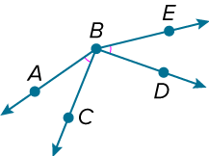
Example 5
Find Counterexamples
b. If ∠ABC ≅ ∠DBE, then ∠ABC and ∠DBE are vertical angles.
When points A, B, and D are noncollinear and points E, B, and C are noncollinear, the conjecture is false.
In the figure, ∠ABC ≅ ∠DBE, but ∠ABC and ∠DBE are not vertical angles.

Slide 26

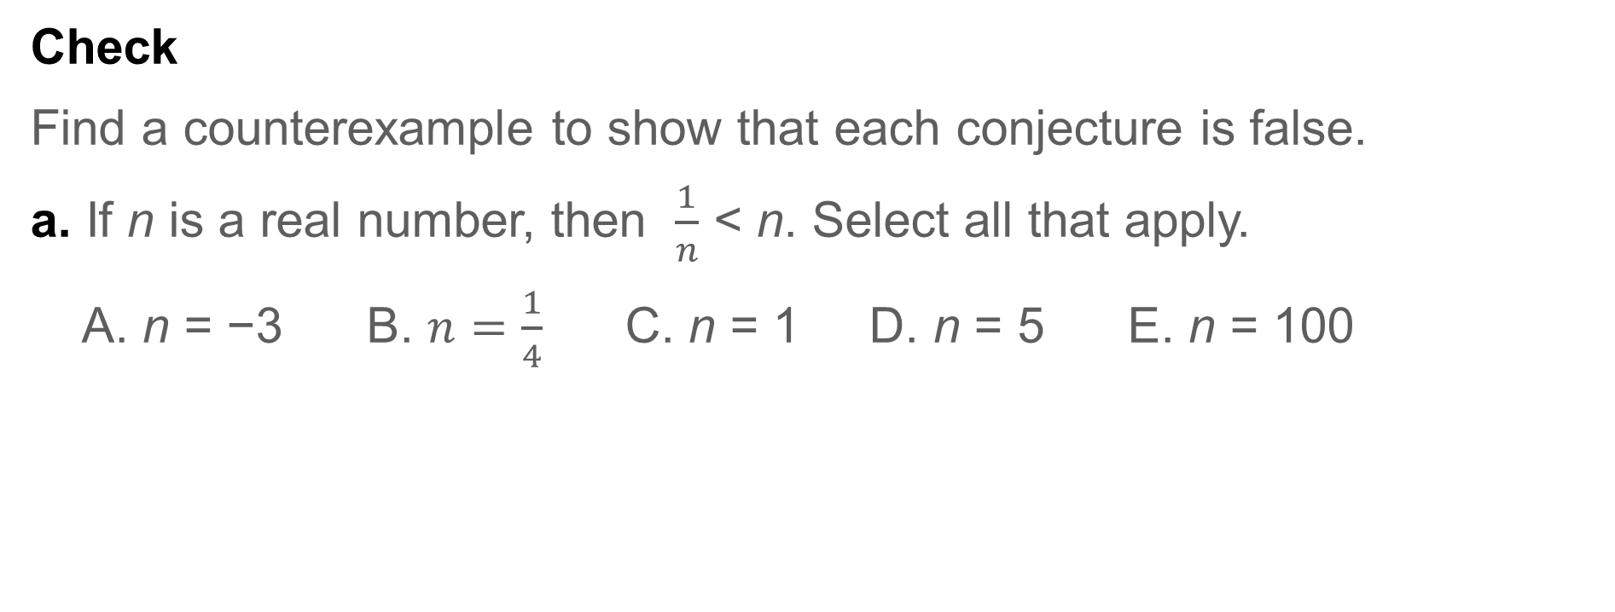
Example 5
Find Counterexamples
Check
Find a counterexample to show that each conjecture is false.
a. If n is a real number, then $\frac{1}{n}$ < n. Select all that apply.
A. n = −3 B. $n=\frac{1}{4}$ C. n = 1 D. n = 5 E. n = 100

Slide 27

Example 5
Find Counterexamples
b. If a line intersects a segment at its midpoint, then the line is perpendicular to the segment. Draw a diagram to represent the counterexample.

Slide 28
Example 5
Find Counterexamples
Check
Find a counterexample to show that each conjecture is false.
a. If n is a real number, then $\frac{1}{n}$ < n. Select all that apply.
A. n = −3 B. $n=\frac{1}{4}$ C. n = 1 D. n = 5 E. n = 100
b. If a line intersects a segment at its midpoint, then the line is perpendicular to the segment. Draw a diagram to represent the counterexample.

Slide 29
Example 5
Find Counterexamples
Check
Find a counterexample to show that each conjecture is false.
a. If n is a real number, then $\frac{1}{n}$ < n. Select all that apply.
A. n = −3 B. $n=\frac{1}{4}$ C. n = 1 D. n = 5 E. n = 100
b. If a line intersects a segment at its midpoint, then the line is perpendicular to the segment. Draw a diagram to represent the counterexample.
Notes:
A
B
C

Slide 30

Exit Ticket
Find a counterexample to show that each conjecture is false.
1. The diameter of every planet in our solar system is less than 100,000 kilometers.
2. Supplementary angles cannot be congruent angles.
3. For every integer n, n³ is positive.
Planet | Radius (km)
Earth | 6378.1
Jupiter | 71,492.0
Mars | 3396.2
Mercury | 2439.7
Neptune | 24,764.0
Saturn | 60,268.0
Uranus | 25,559.0
Venus | 6051.8
Source: NASA

Slide 31
Exit Ticket
Find a counterexample to show that each conjecture is false.
1. The diameter of every planet in our solar system is less than 100,000 kilometers. Jupiter or Saturn
2. Supplementary angles cannot be congruent angles. two right angles
3. For every integer n, n³ is positive. n ≤ 0
Planet | Radius (km)
Earth | 6378.1
Jupiter | 71,492.0
Mars | 3396.2
Mercury | 2439.7
Neptune | 24,764.0
Saturn | 60,268.0
Uranus | 25,559.0
Venus | 6051.8
Source: NASA
Notes:
Jupiter or Saturn
two right angles
n ≤ 0

