Slide 1
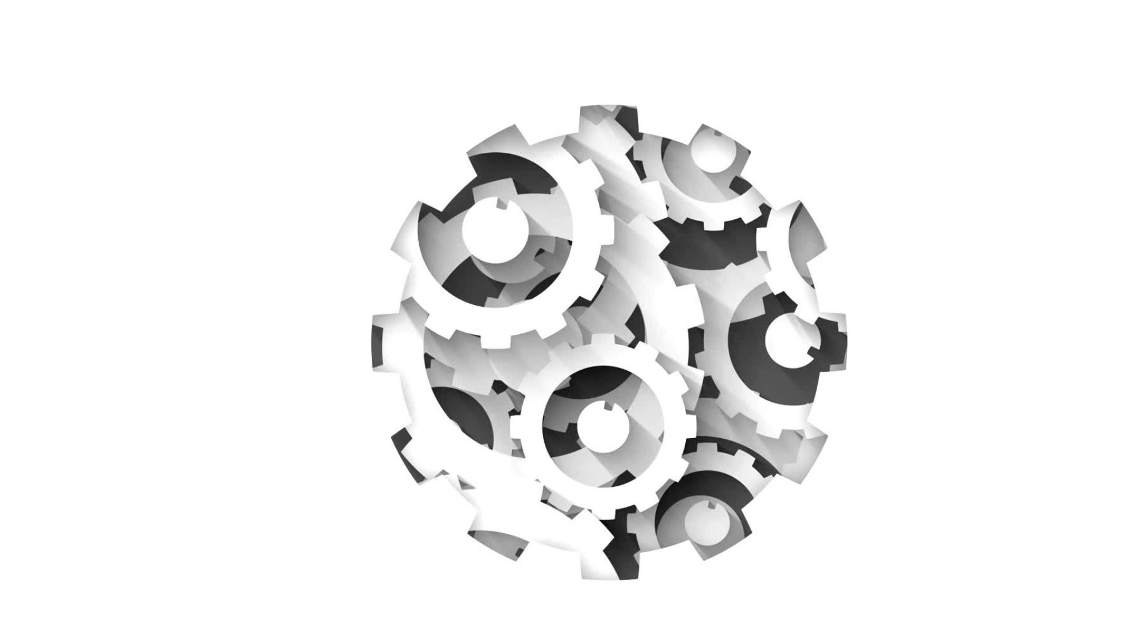
Constructions
Geometry

Slide 2
https://www.mathopenref.com/tocs/constructionstoc.html

Slide 3
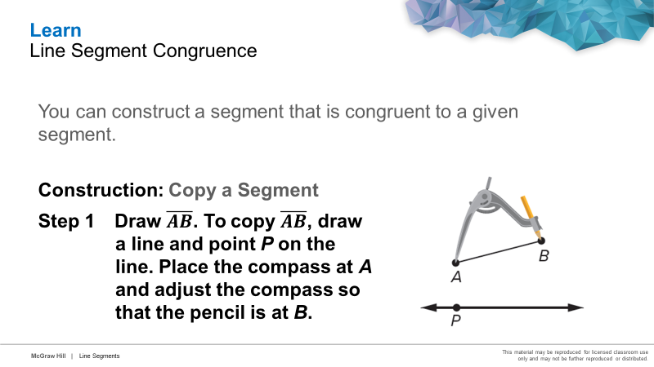

Slide 4
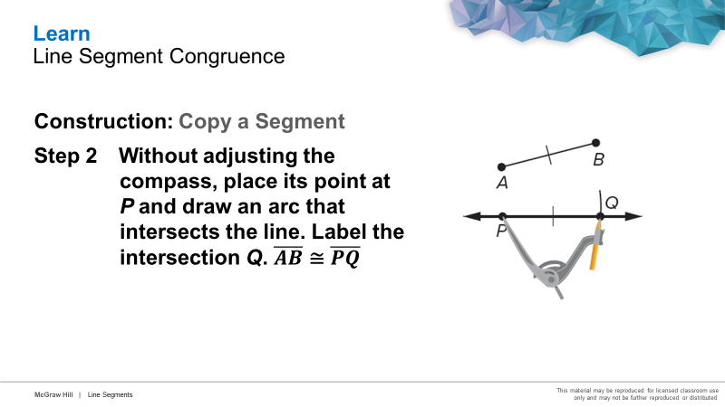

Slide 5
Learn
Bisectors
Because the midpoint separates a segment into two congruent segments, we can say that the midpoint bisects the segment. Any segment, line, plane, or point that bisects a segment is called a segment bisector.

Slide 6
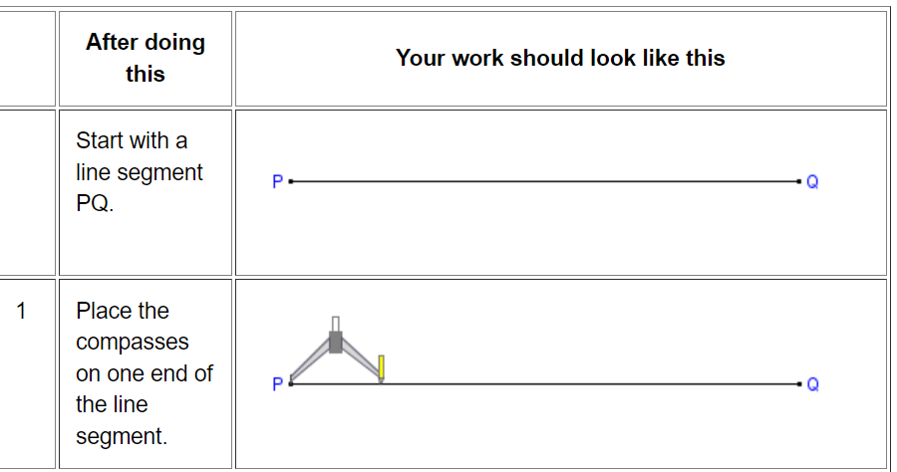

Slide 7
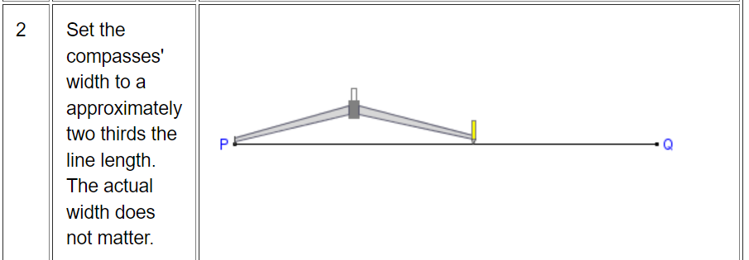

Slide 8
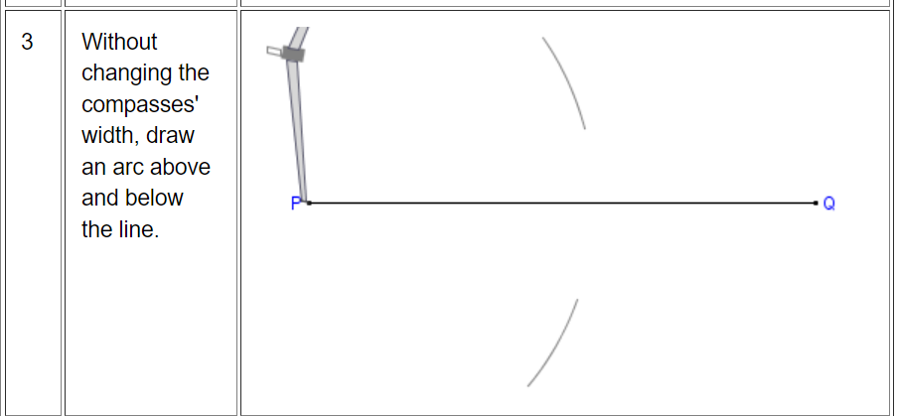

Slide 9
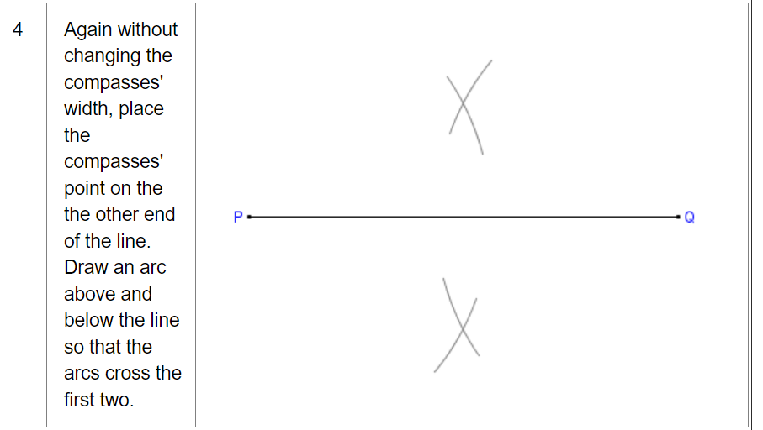

Slide 10
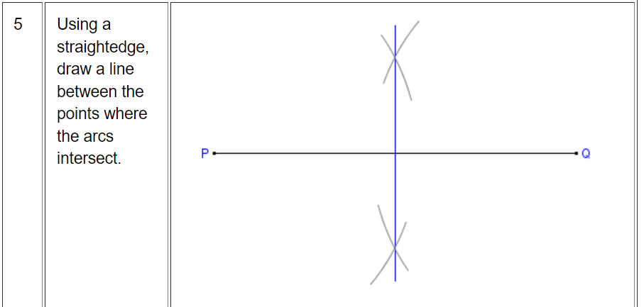

Slide 11
