Slide 1
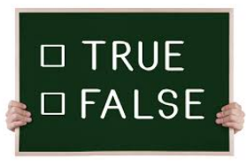

True or False!
A ruler can be used to measure segments in any construction.
Measuring devises such as rulers and protractors are NOT used in constructions.

Slide 2
True or False!
Several types of compasses may be used in geometric constructions.

Slide 3
True or False!
A small part of an entire circle is called an arc. Arcs are used in geometric constructions.

Slide 4
True or False!
Two arcs intersect in a line.
Two arcs intersect at a point.

Slide 5
True or False!
A compass can be used to construct a full circle.

Slide 6
True or False!
A basic construction is copying a line segment.

Slide 7
True or False!
Practice using a straightedge and compass will help in more complex geometric constructions.

