Slide 1
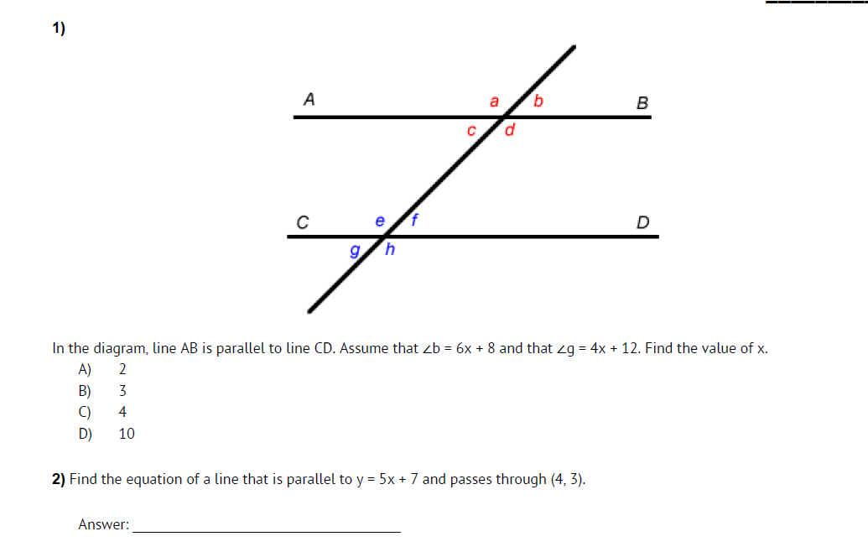
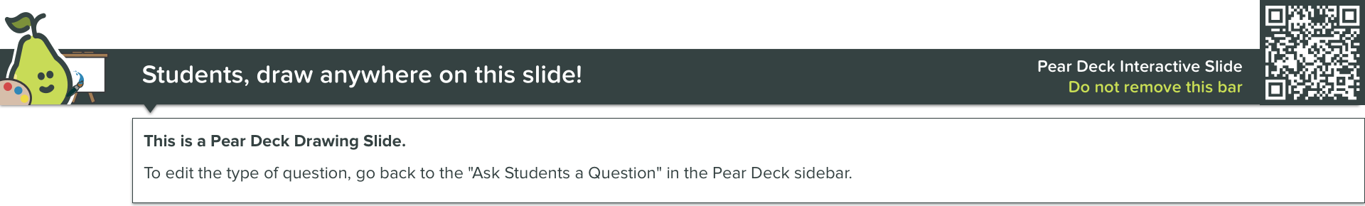
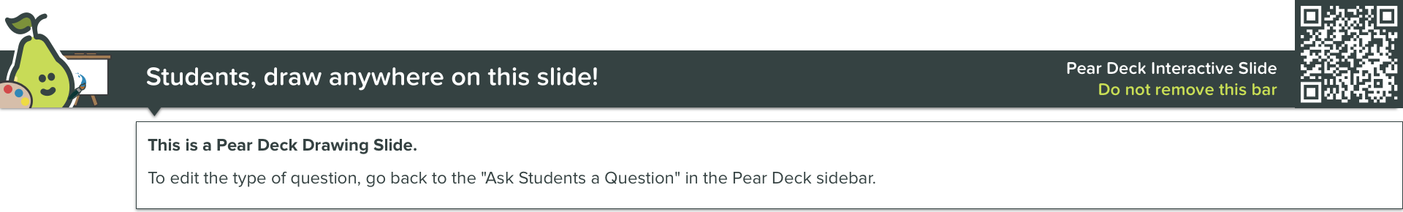

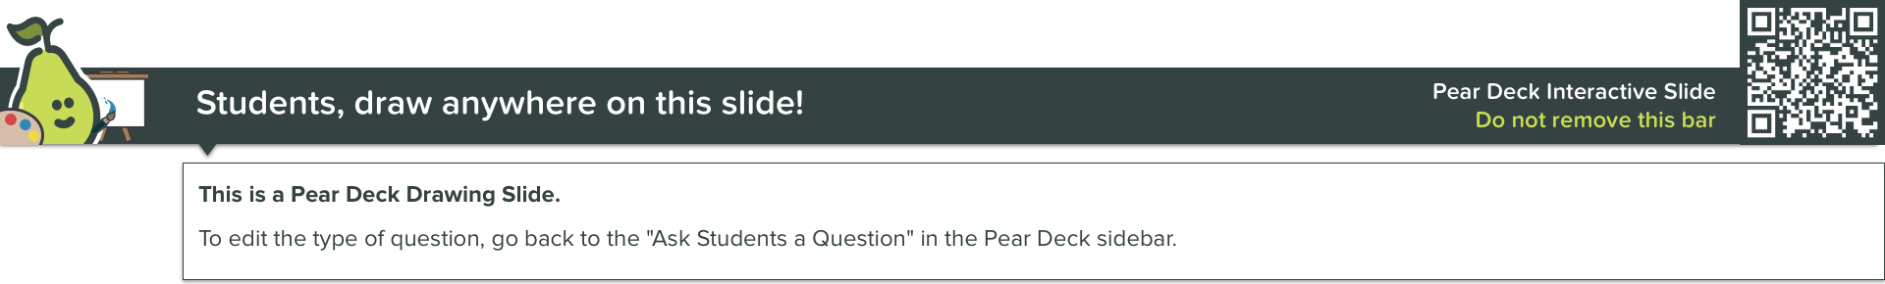
Hint: alternate exterior angles are congruent!
Hint: Parallel lines have the same slope. Graph or use
Slope intercept form to substitute the point & slope: y=mx+b or point-slope form y-y1=m(x-x1)

Slide 2
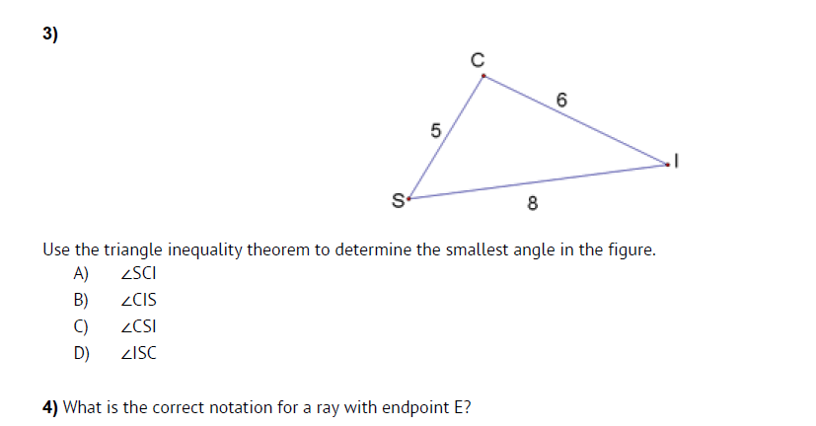
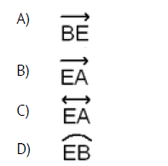


Hint: the smallest side is across from the smallest angle and the largest side is across from the largest angle – also remember the sum of two sides must be greater than the third.
Hint: A ray has one endpoint and goes forever in one direction - know your vocabulary for line, line segment, and ray.

Slide 3
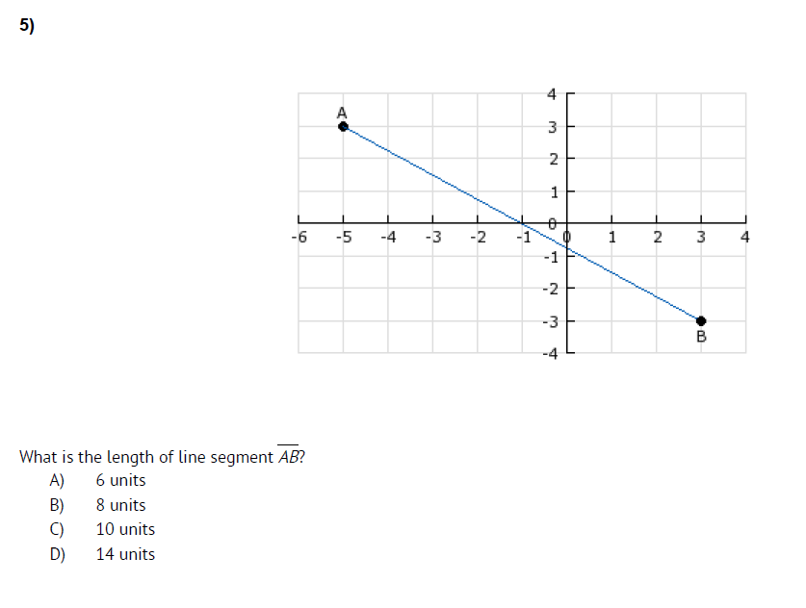

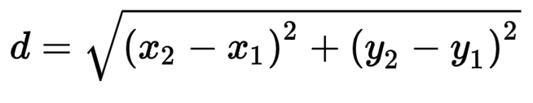


Hint: Use pythagoren theorem
Or distance formula

Slide 4
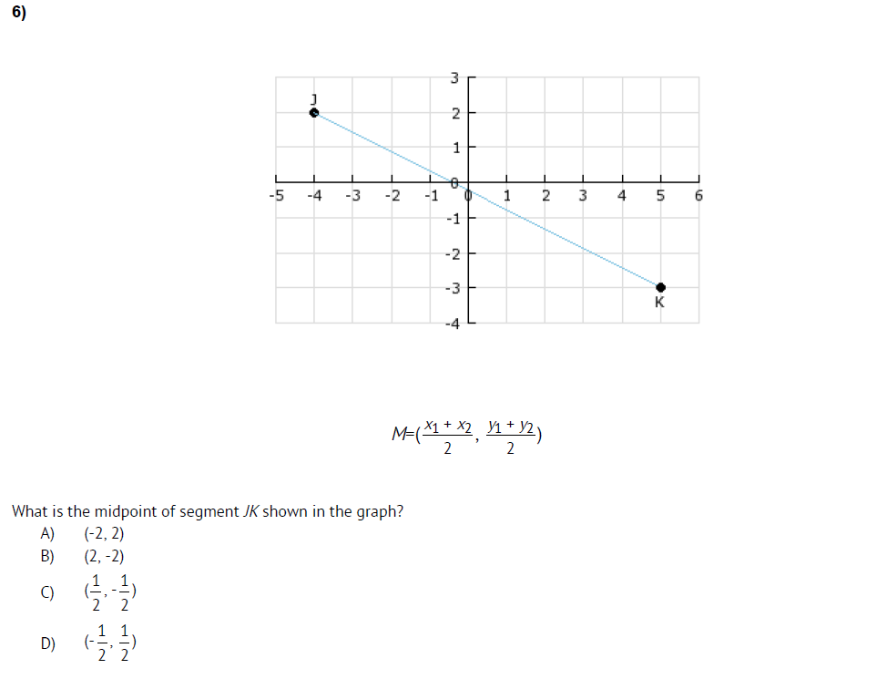



Slide 5
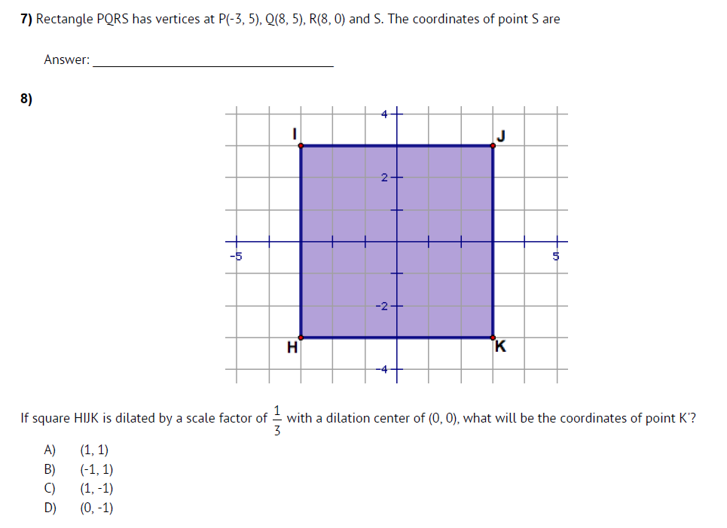

Hint: a rectangle has 4 right angles (perpendicular slopes which are negative reciprocals) and opposite sides congruent.
Hint: Multiply the scale factor!

Slide 6
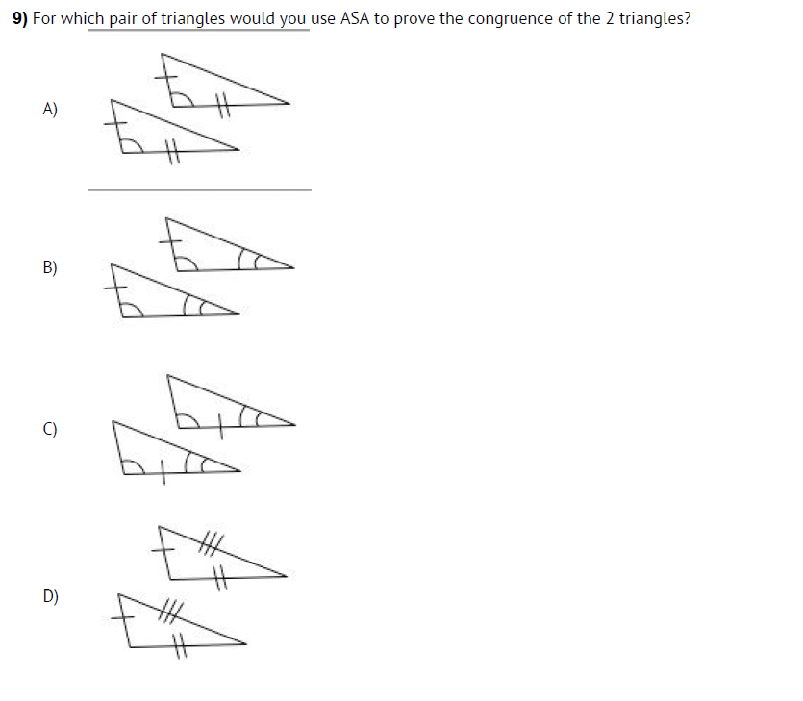

Hint: Use your foldable and think about where the side is located compared t the two sides.

Slide 7
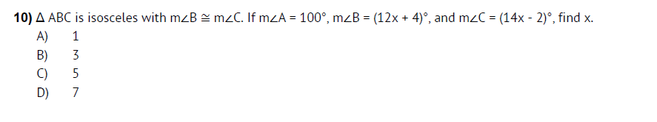

Hint: Two sides of the triangle are congruent and so are the two base angles. Draw the triangle out and label!

Slide 8
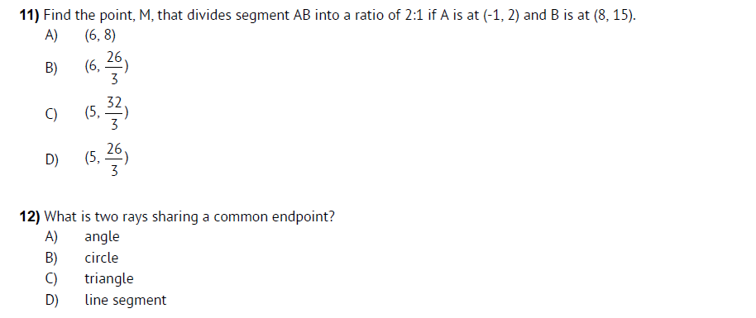

Hint: remember you have 3 total parts – you are going 2/3 of the way! Find your slope (no simplifying). Then multiply the slope by 2/3. Add to the coordinates of point A.
Hint: know your vocabulary and draw out each choice!

Slide 9
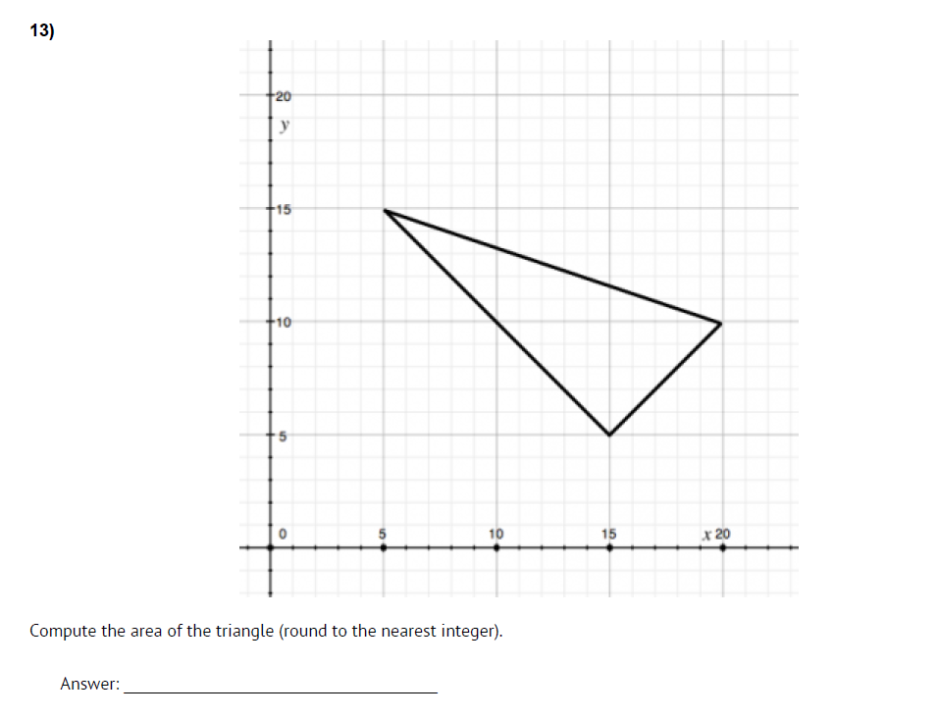

Hint: area formula is ½ bh
Find the length of the base
And height – use distance formula or pythagorean theorem.

Slide 10
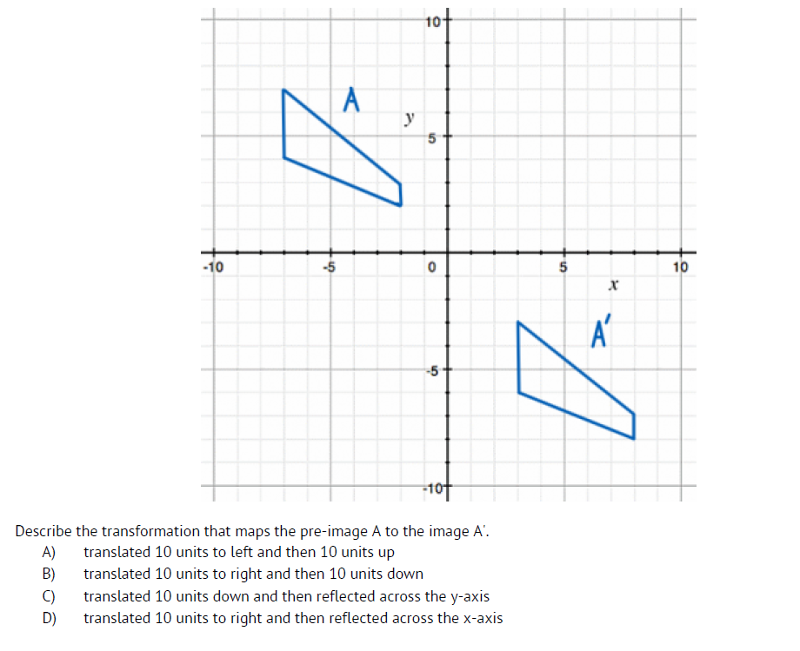

Hint: translation is a slide
The pre-image is the original (A) the new image is A' know your rules and how to do translations and reflections.

Slide 11
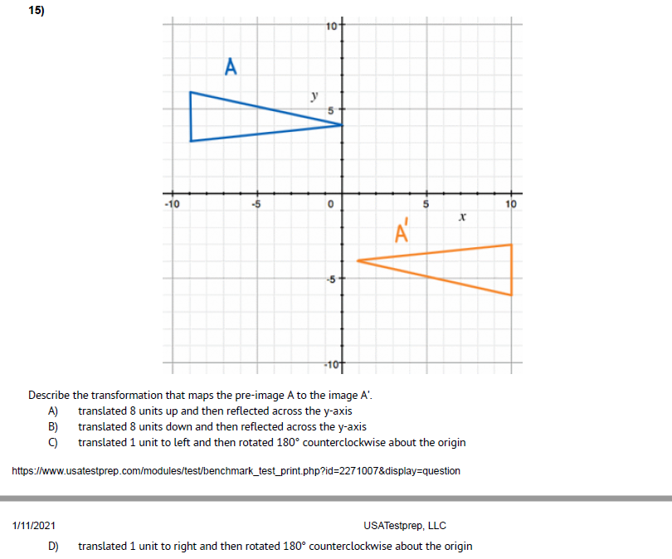
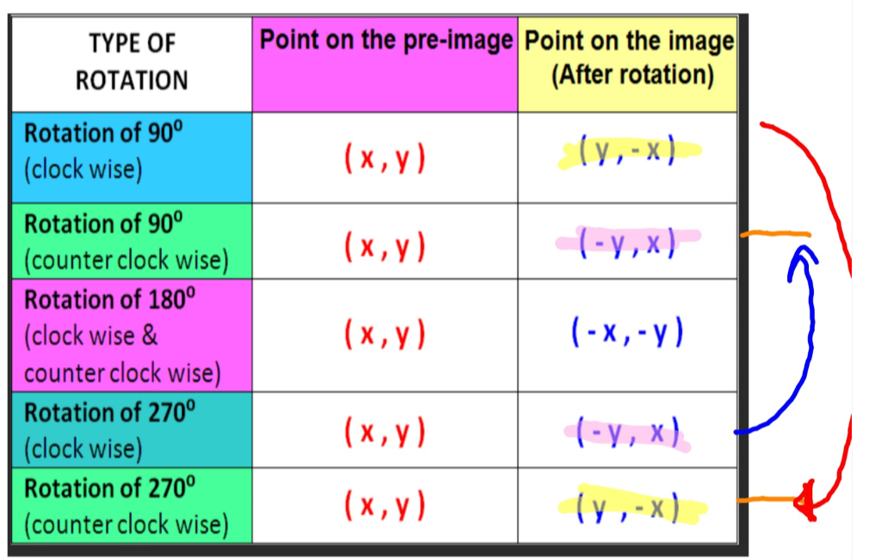

Hint: Know your transformations!
Translation (slide)
Rotation Rules:

Slide 12
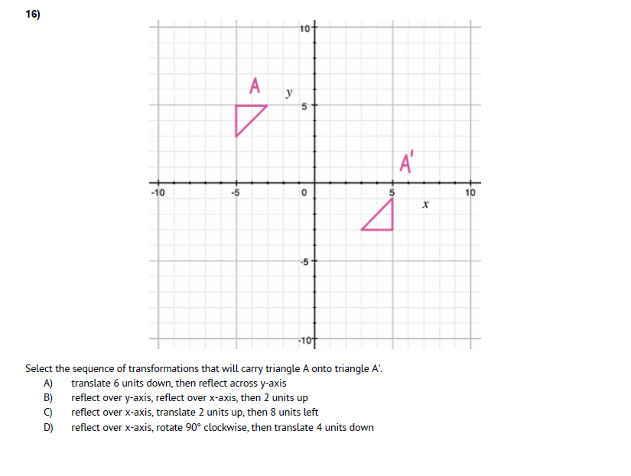

Hint: Know your transformations!
Translation (slide)
Rotation Rules:

Slide 13
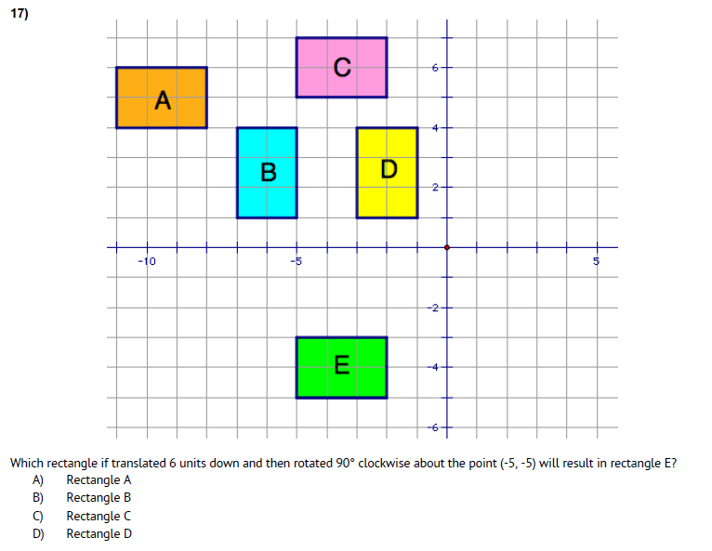

Hint: Know your transformations!
Translation (slide)
Rotation Rules:

Slide 14
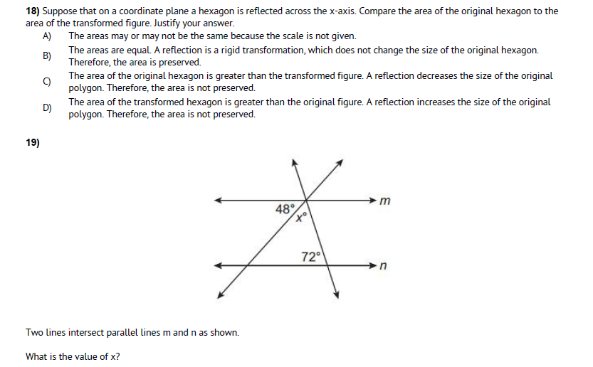


Hint: know your definition of rigid motion – which include translations, reflections, and rotations.
Hint: Straight line is 180 degrees. Parallel lines with transversals have alternate interior angles!

Slide 15
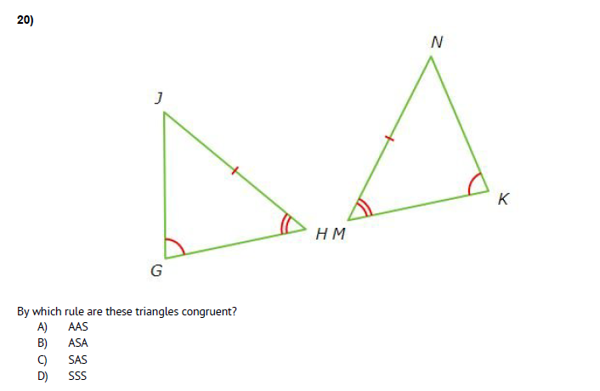

Hint: Use your foldable!

Slide 16
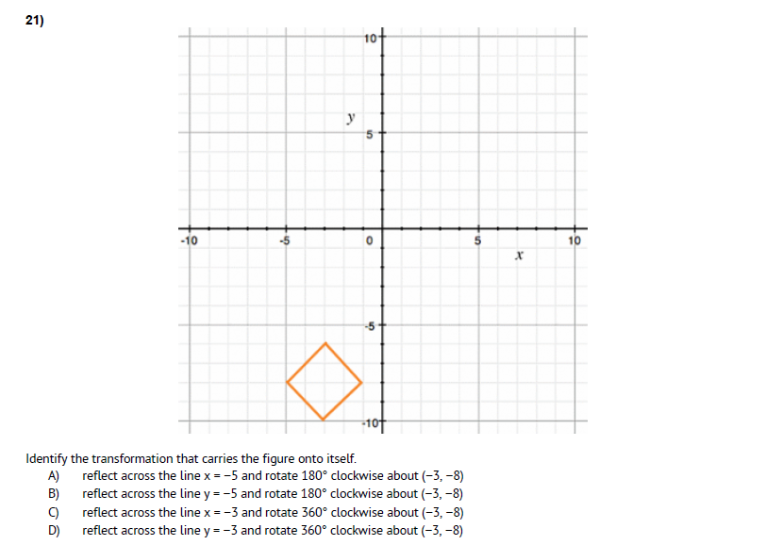
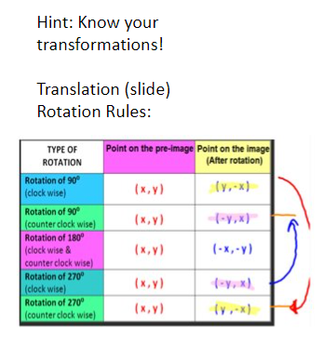


Slide 17
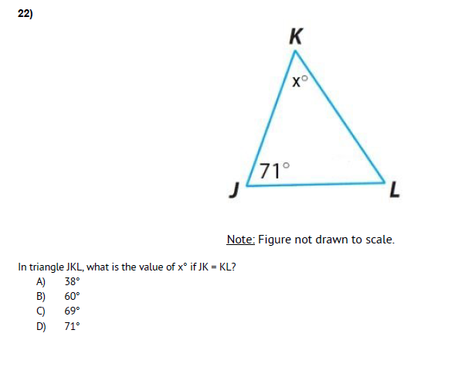

Hint: This is an isosceles triangle when two sides are congruent so are your base angles –also remember there are 180 degrees in a triangle!

Slide 18
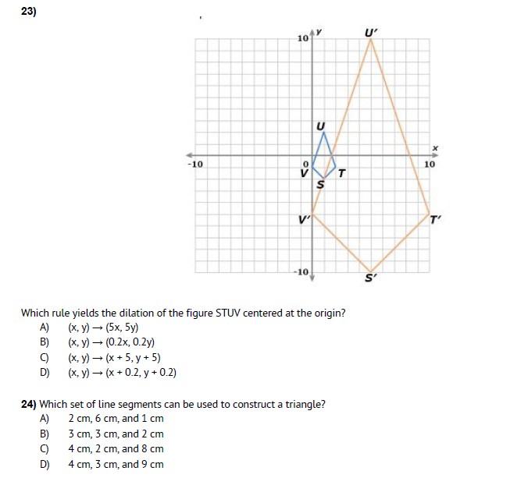

Hint: New figure has prime markings (S') multiply the scale factor by the ordered pairs or a side length of the original to see!
Hint: Remember the sum of two sides of a triangle must be greater than the third side!

Slide 19
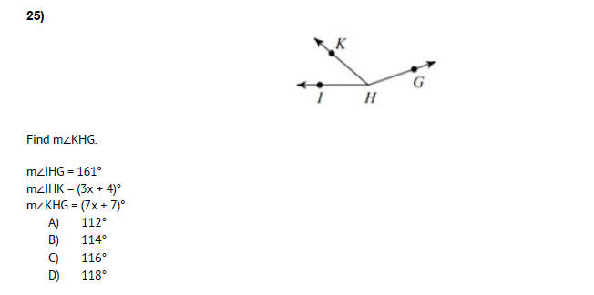

Hint: Angle Addition! Label all the angles! This looks like the same question from your benchmark test!

Slide 20
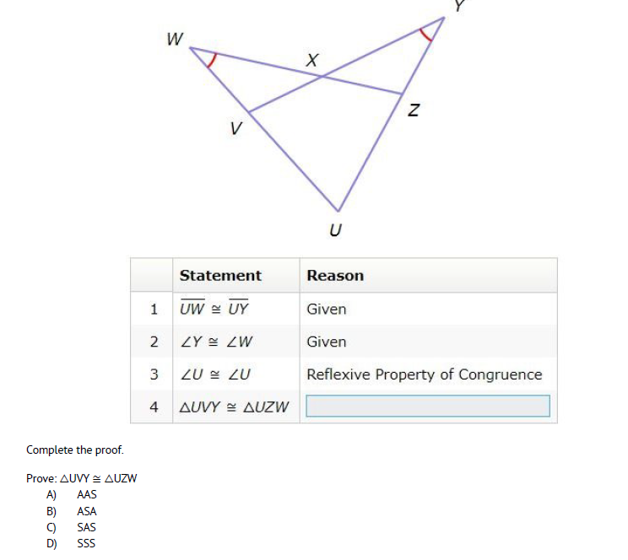

Hint: Draw the triangles out separately and mark what you know. Use your foldable!

Slide 21
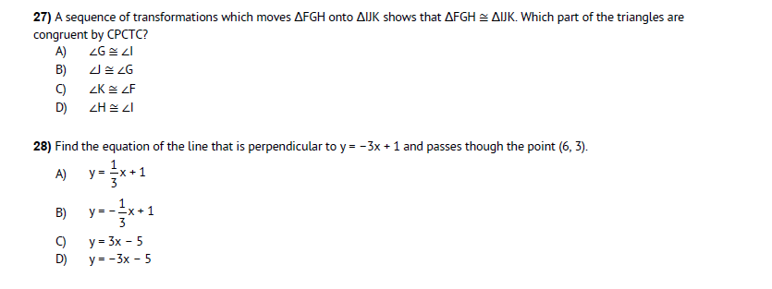

Hint: CPCTC stands for Corresponding Parts of Congruent Triangles are Congruent – this is used after you have proved two triangles are congruent because all the parts are congruent too now (angles and sides).
Hint: perpendicular slopes are negative reciprocals. Then either graph or use points-slope or slope intercept form to solve.
Y= mx + b or y-y1=m(x-x1)

