Slide 1

Ram 4: Respect
PBIS Lesson 1
Respectful Responsible Resilient Ready

Slide 2
What is PBIS and what does it look like at Riverview?
PBIS stands for Positive Behavioral Interventions and Support!
The mission of PBIS at Riverview is to promote a safe and positive school environment that enhances student learning through teaching and celebrating positive behaviors, which will empower respectful, responsible, ready and resilient citizens.
The vision of the RHS PBIS program is to strengthen student accountability and ownership of behavior and learning by working together as one for the success of all.

Slide 3

Lesson 1 RESPECT: Learning Intention
Teachers and students will be able to effectively identify appropriate behaviors in each area of RAM4, specifically this Month’s trait of RESPECT!
Create a Chart/Visual to hang OUTSIDE each classroom that states what Respect Looks Like and Sounds Like at school and with friends

Slide 4
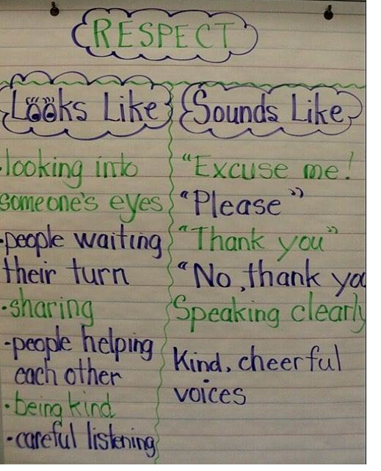
Material and Instructions
Large Chart Paper- Located in Each Teacher Planning Room and use any markers, sticky notes & any other creative elements you want to add.
You can create anything you like that is visually appealing and includes the trait RESPECT!
  You are free to design this activity however fits best for your classroom!
Please include RAM 4 on your lesson & the RAM 4 trait: RESPECT
Complete this with any class period and post outside your classroom door in the hallway by September 23rd!

Slide 5

What does RESPECT look like…
Here are some examples!
RPAC:
Turn off phone and listen. Keep a low voice. Clap appropriately. Leave hats and hoods off.
GYM:
Wait their turn in line. Use respectful words and tone. Be kind to game officials. Refrain from heckling.
BATHROOM:
Maintain boundaries. Refrain from offensive comments. Respect others' space.
MEDIA CENTER:
Wait your turn in line. Use respectful words and tone. Keep voice/conversations volume low.
CAFETERIA:
Wait your turn in line. Use respectful words. Keep voice/conversations volume low. Include others. Use manners.
CLASSROOM:
Respect others' space, property, and ideas. Use appropriate language & tone. Follow classroom guidelines.
HALLWAYS:
Avoid physical contact. Respect others personal space. Use appropriate language & tone of voice.

Slide 6
Questions?
Please contact the PBIS team if you have any questions, concerns, or suggestions for how to improve this system!
Erin del Castillo
Ashley Hernandez
Jay Lorenz
Jennifer Eastman-Miller
Chad Smith
Jessica Bies
John Douglas
Tina Asadorian
Ciara Van Ness
Jeff Harris
Paige Taber
Justin Martin
Joe Bazenas

