Slide 1

Booker Middle School
Rules and Procedures

Slide 2
Welcome Back!
We missed you!
* Take a moment to share something you did this summer by raising your hand.

Slide 3

What is Booker Middle’s Mission and Vision for 2020-2021
Mission: High expectations for ALL.
Vision: Inspiring tomorrow’s leaders.

Slide 4




Booker Creed
z

Slide 5
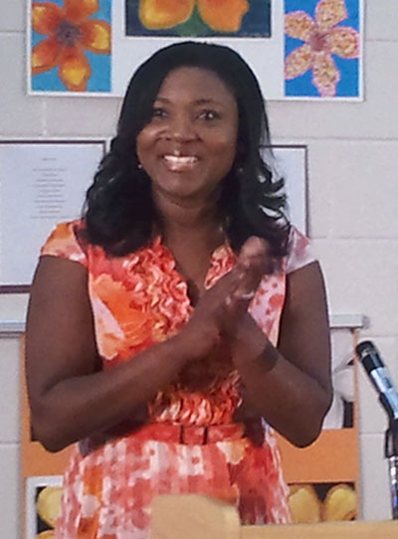
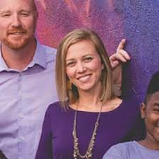
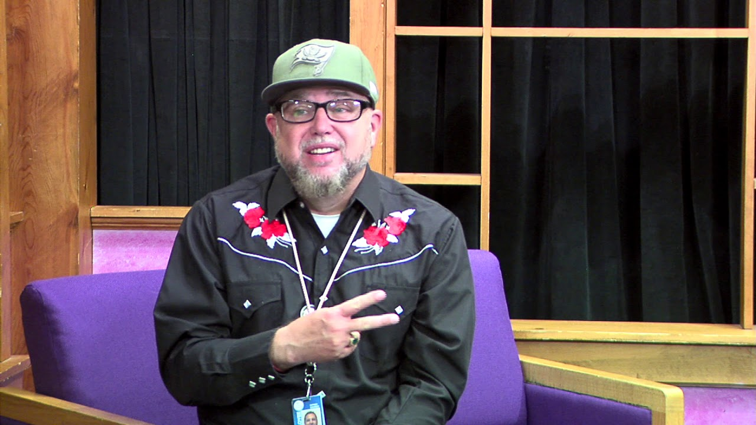
Meet your admin
Principal: Dr. Frost
Vice Principal: Mrs. Parker
Vice Principal: Mr. Jenkins

Slide 6

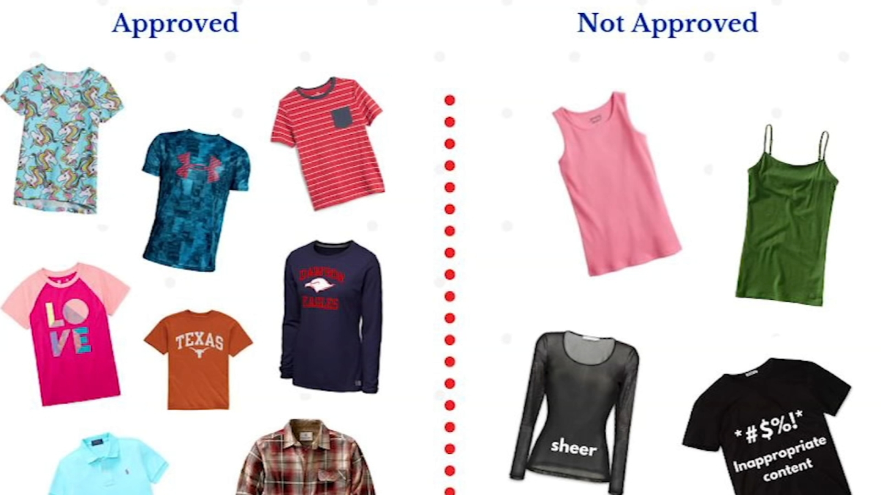
Sleepwear and swimwear are not permitted on campus
Tops must have sleeves and cover the full front and back with no gaps or holes.
Bottoms may not hang down or show underwear. Bottoms must fall at or below the fingertips. No holes in pants above the knee.
Shoes must be worn at all times.
Jewelry must be worn safely and be nonhazardous.

Slide 7

Cell phone policy
All electronic devices must be turned off and stored in the backpack at ALL times on campus.

Slide 8
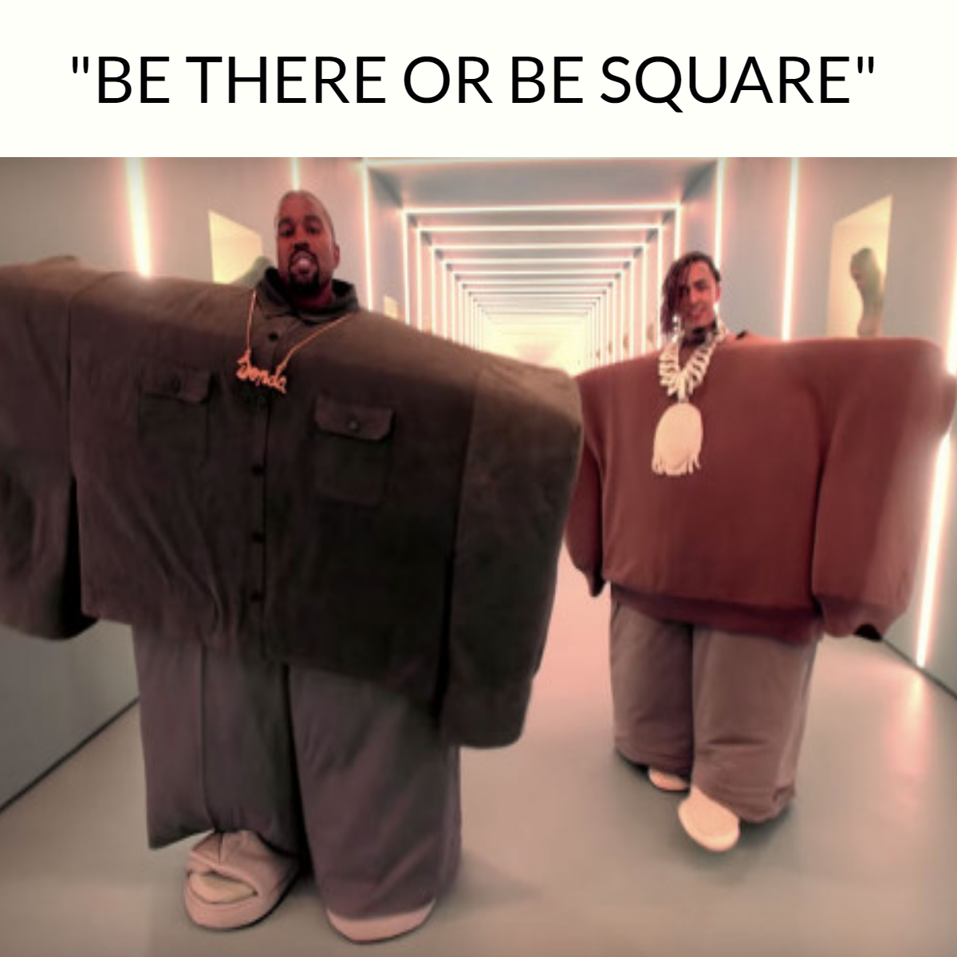
Attendance
Be here or be square!
Students have 3 days from an absence to bring in excused paper work.
SIR’s for tardies
Referral’s after 5 tardies

Slide 9
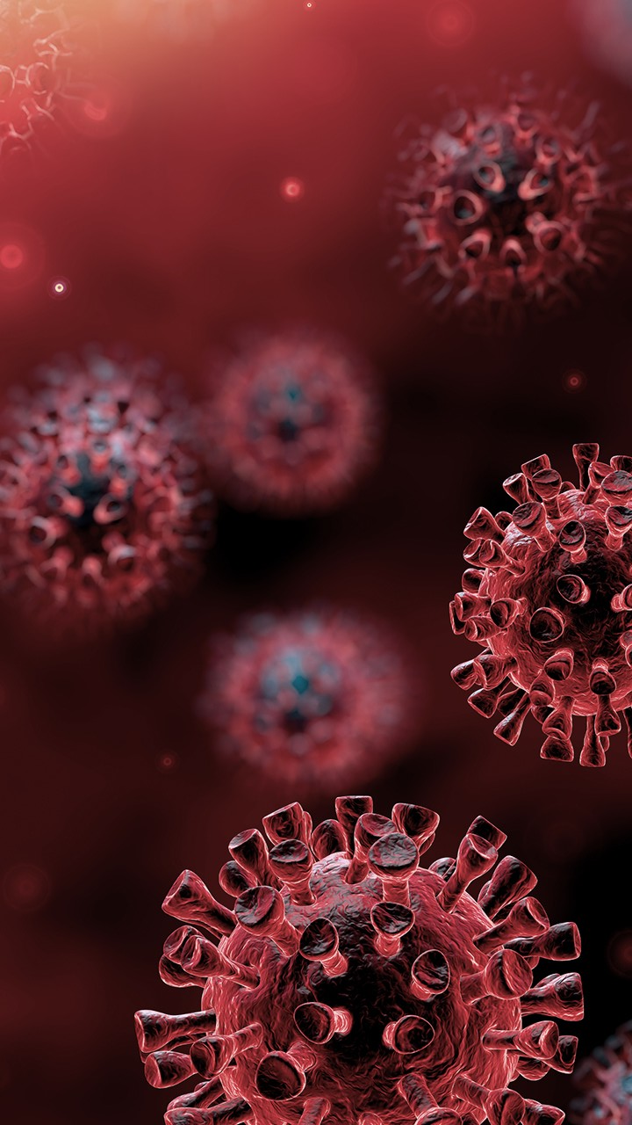
Changes due to Covid
Masks – Must be worn at all times other than actively eating.
Social Distancing – students must maintain a 6 feet distance from their peers as much as physically possible.
Walking Paths – students must adhere to the walking arrows to ensure safe transitions on campus.
Classroom Layouts – classrooms look a bit different please follow teachers instructions for each class.
Hand Sanitizing and Washing – please sanitize your hands after touching any surfaces and wash your hands throughout the day, scrubbing for 20 seconds and rinsing with hands pointing down into sink.
Sports and Afterschool programs – n/a

Slide 10

Let’s review the school procedures
Turn to your student handbook. Look through pages 7-10 these pages discuss bus transportation, cafeteria procedures, campus movement, safety procedures, and visitor procedures.
Give students a moment to look through. Allow students to ask questions if they are confused.

